Slide 1
BLS Assist &
Medic Unit Operations
Medication and Equipment Restocking

Slide 2
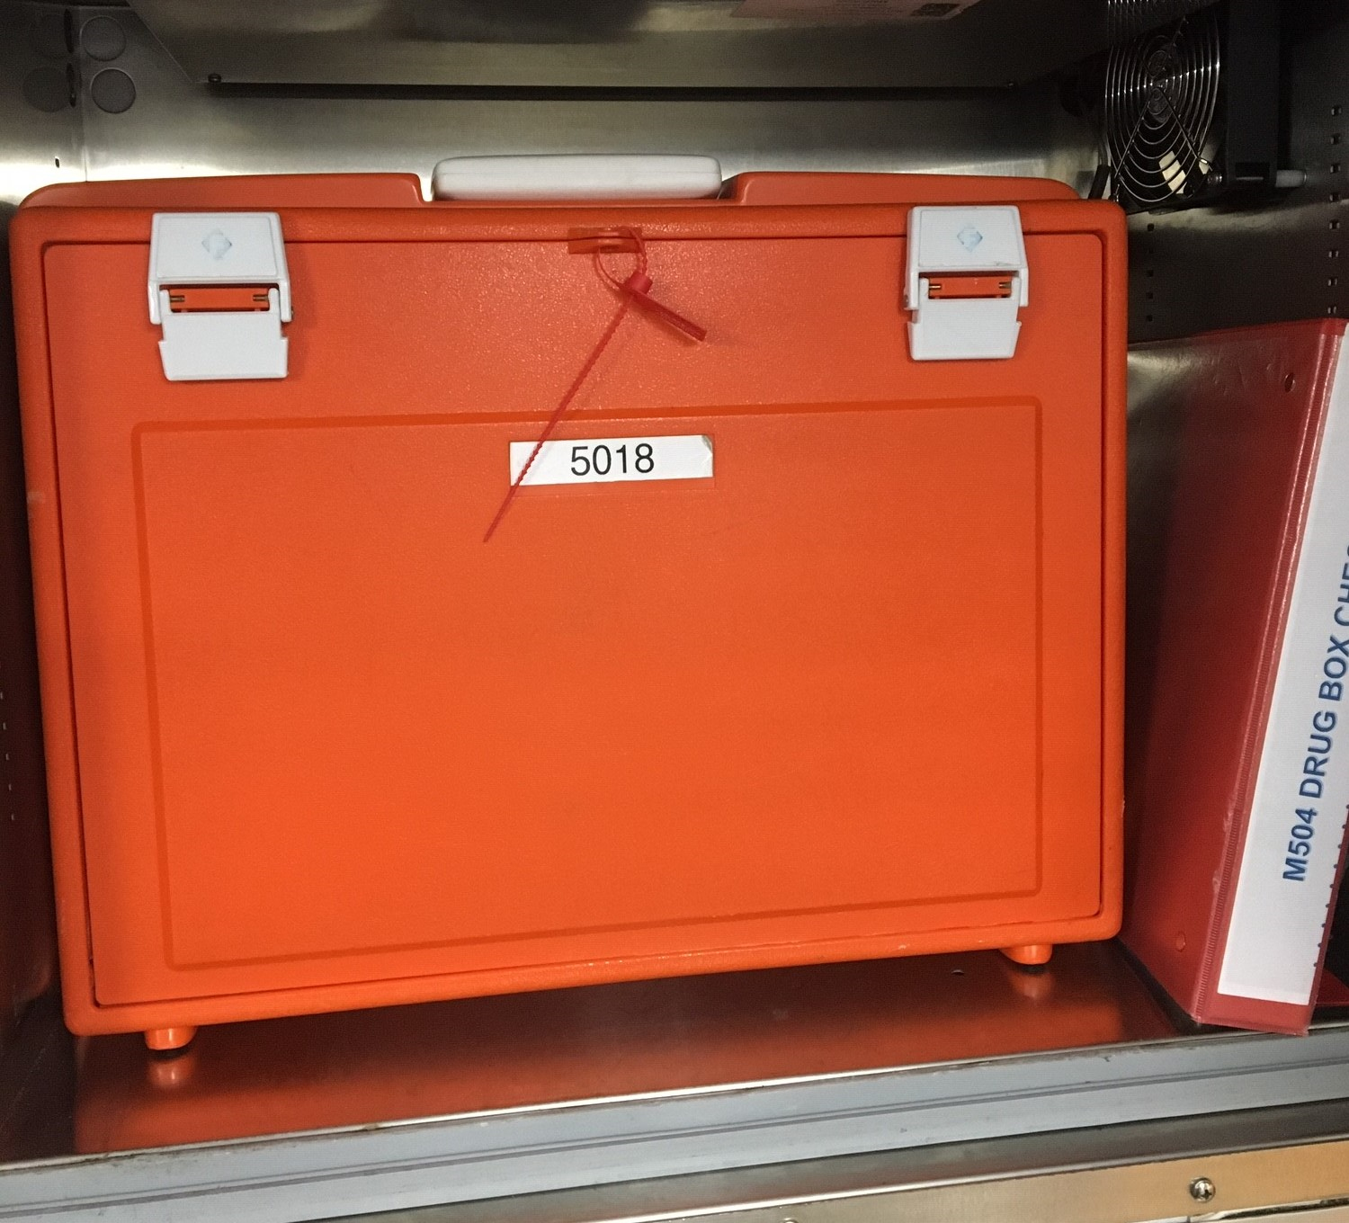
This presentation is part of a series designed to help familiarize PWC BLS providers with medic unit operations. This information will be a refresher for many providers, but consider that experience varies by rank and assignment. It is not intended to be a protocol review or a substitute for in station training. This presentation covers the administrative work after transport. Please refer to the PWC EMS Resource Page for relevant documents and policies.

Slide 3
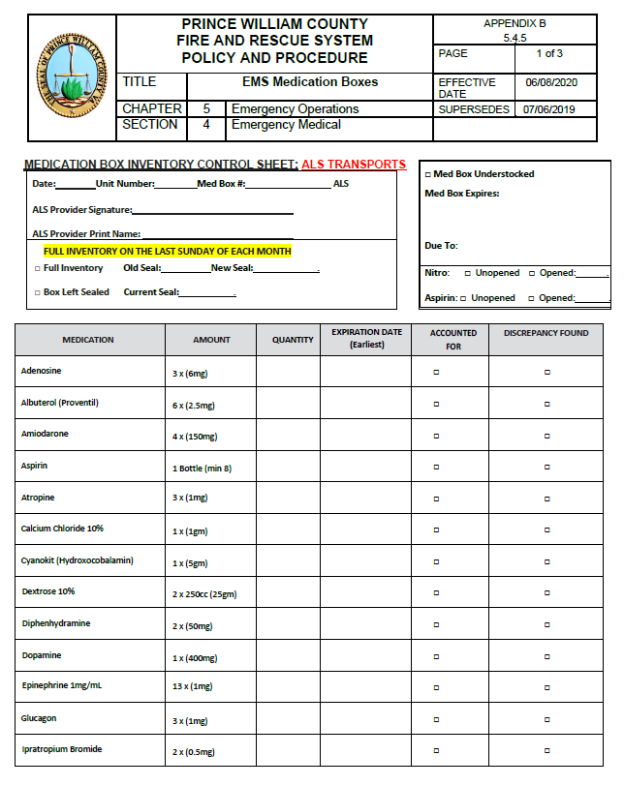
Med Box Inventory
OMD Directive 5.4.5 EMS Medication Boxes covers the inventory process
A medication box inventory control sheet is completed every morning and whenever a numbered seal is broken.

Slide 4
Med Box Inventory
OMD Directive 5.4.5 EMS Medication Boxes
4.2.2.2.
Endorsed EMS personnel staffing ALS or BLS units shall ensure that the drug box is present and verify existing seal number on the box at the beginning of each shift. This will be documented in the coexisting logbook and then the boxes will be re-secured. If seal is intact and seal number is unchanged a complete medication inventory and expiration date check is optional.

Slide 5
Med Box Inventory
OMD Directive 5.4.5 EMS Medication Boxes
4.2.2.3.
When a med box is utilized (seal broken), a complete inventory and restocking of used items shall be performed prior to the box being re-sealed and returned to service. The Controlled substance Kit (CSK) must be visually inspected every time the drug box is opened whether or not controlled substances have been accessed. An inventory sheet (Appendix A, B, or C) must be completed to verify proper medication quantities. An exchange sheet must be completed and submitted for medication replacement. The medication expiration date column must be completed for any new medication being exchanged or replaced.

Slide 6
Med Box Inventory
OMD Directive 5.4.5 EMS Medication Boxes
4.2.2.3.
On the last Sunday of the month, all med boxes shall be opened and FULLY inventoried to include unstaffed units. Medications will be exchanged at the hospital prior to expiration. Complete an inventory sheet (Appendix A, B or C) including the medication expiration date column, and if indicated, complete an exchange form for exchange of expiring medications. Follow the applicable hospital and/ or pharmacy procedures for exchanging medications.

Slide 7
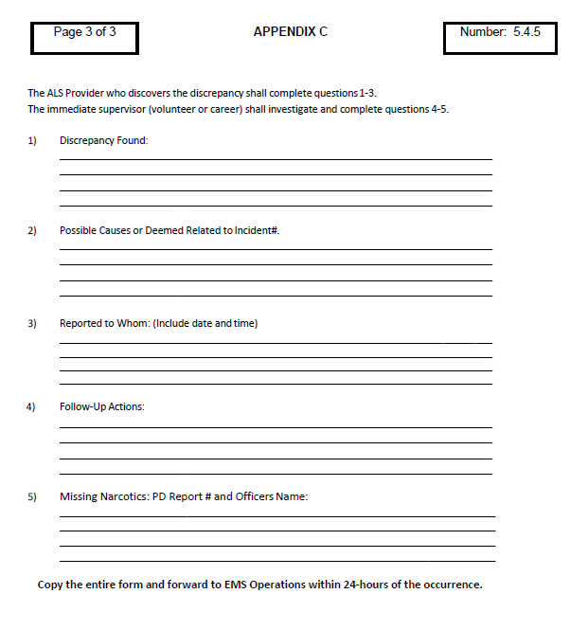
Med Box Inventory
Discrepancies must be reported to the immediate supervisor and Battalion Chief.
A discrepancy involving the Regional CSK must also be reported to the County Police.

Slide 8
Medication Exchange
Routine medication exchange (non narcotics) requires a completed “EMS Drug Issue Sheet” with attached Hospital ID sticker and signature of RN performing the exchange.
The ER charge nurse will perform this exchange at PWH and Haymarket Hospital. ALS providers can perform medication exchange at Sentara Hospital EMS room pyxis. The Sentara ER charge nurse may also perform the exchange if the pyxis is inadequate.

Slide 9
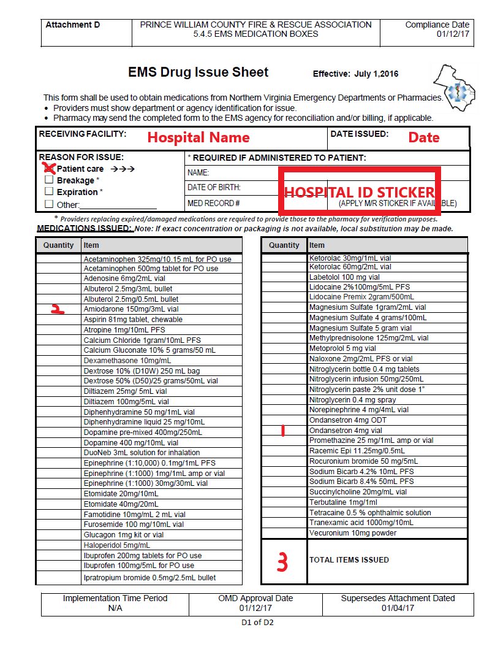
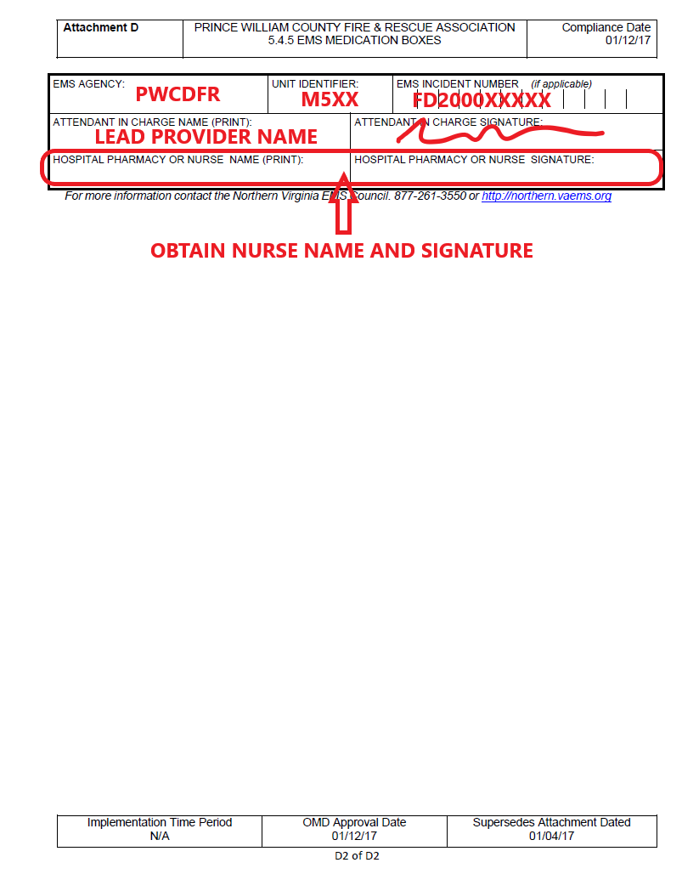

Slide 10
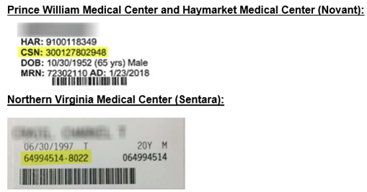
Hospital ID Stickers

Slide 11
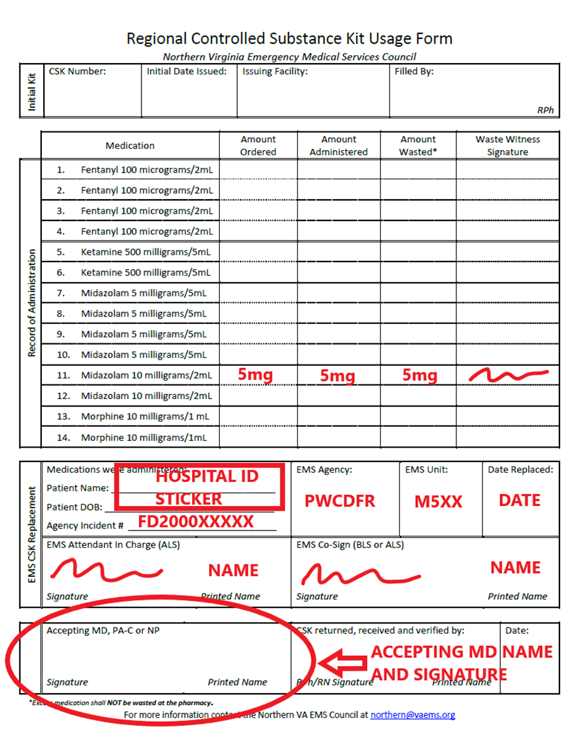
Narcotics Exchange
The ALS provider is responsible for restocking narcotics and completing the Regional CSK paperwork (located inside the control numbered pouch).
This paperwork requires the BLS provider’s signature as “EMS Co-sign” and possibly a “waste witness” signature.
Narcotics exchange requires a printed copy of the PCR.

Slide 12
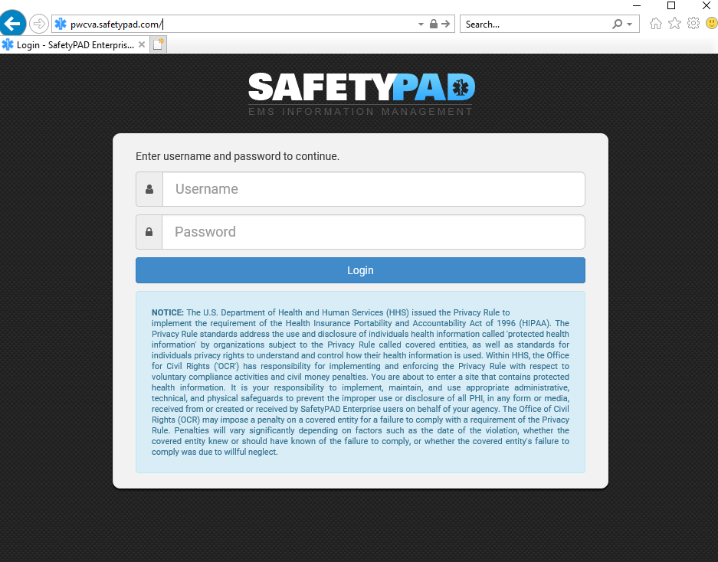
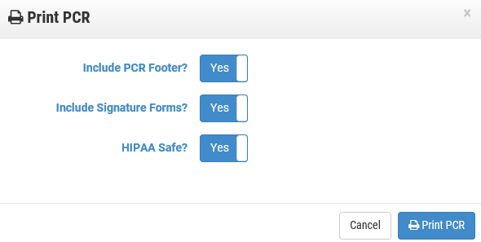
Printing a PCR
Login to SafetyPAD Enterprise at pwcva.safetypad.com then select and view the desired incident PCR using PCR Search. Use the printer icon when viewing the report.
Printed HIPAA compliant PCRs do not have the required information (patient name, DOB). Hospital ID stickers must be placed on every page of the printed PCR to complete the Regional CSK exchange.

Slide 13
Equipment Restocking
Linens are restocked in a one for one exchange. Carts containing EMS linens are typically marked and located near the ambulance entrance. Other linen carts and fitted sheets should not be used.
Some equipment cannot be restocked at the hospital and must be obtained back at the station. Examples include IO needles, ET tubes, CPAP circuits, Airtraq and traditional laryngoscope blades, etc.

Slide 14
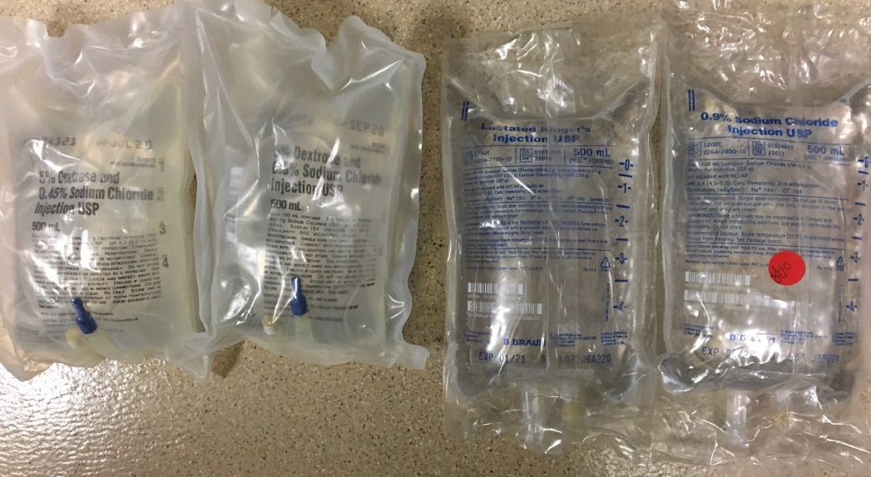
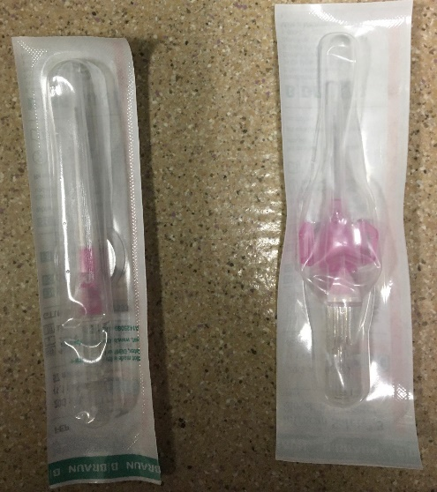
Equipment Restocking
Pay attention to detail when restocking and don’t be afraid to ask. Some hospital equipment may look similar to what is carried on a medic unit. IV fluids may be packaged almost identically but contain 0.9% Normal Saline, 10% Dextrose, Lactated Ringers, D5W, etc.
Some needles, IVs, syringes, etc are not appropriate for medic unit restocking.

Slide 15
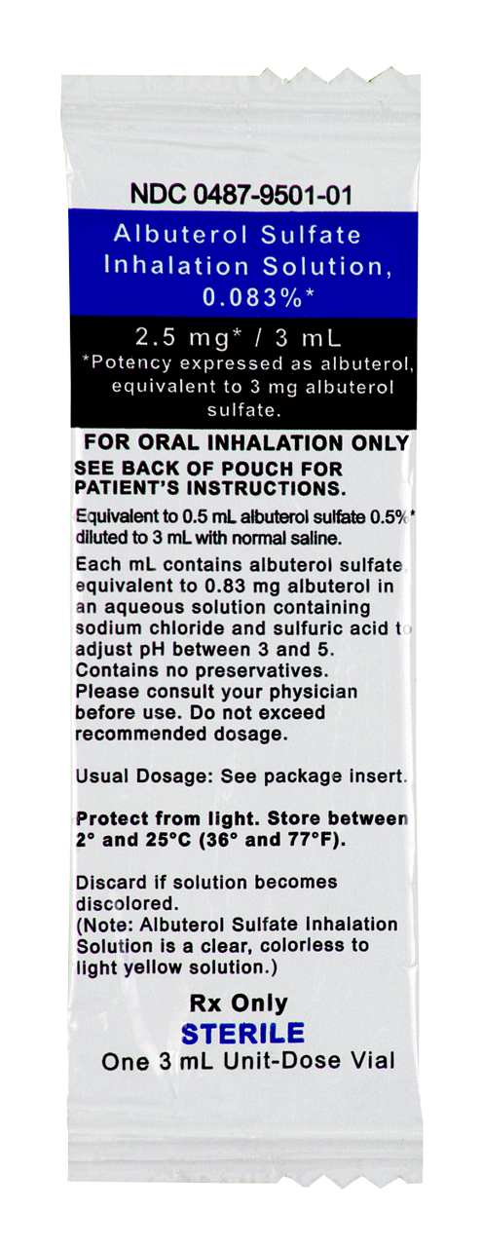
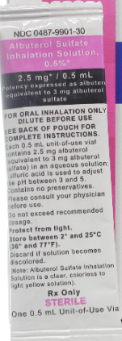
Medication Restocking
Medications may come in different packaging. Some cases are normal variations between manufacturers, others are more significant.
Pay attention to medication name, concentration, expiration date, listed routes, etc.

Slide 16
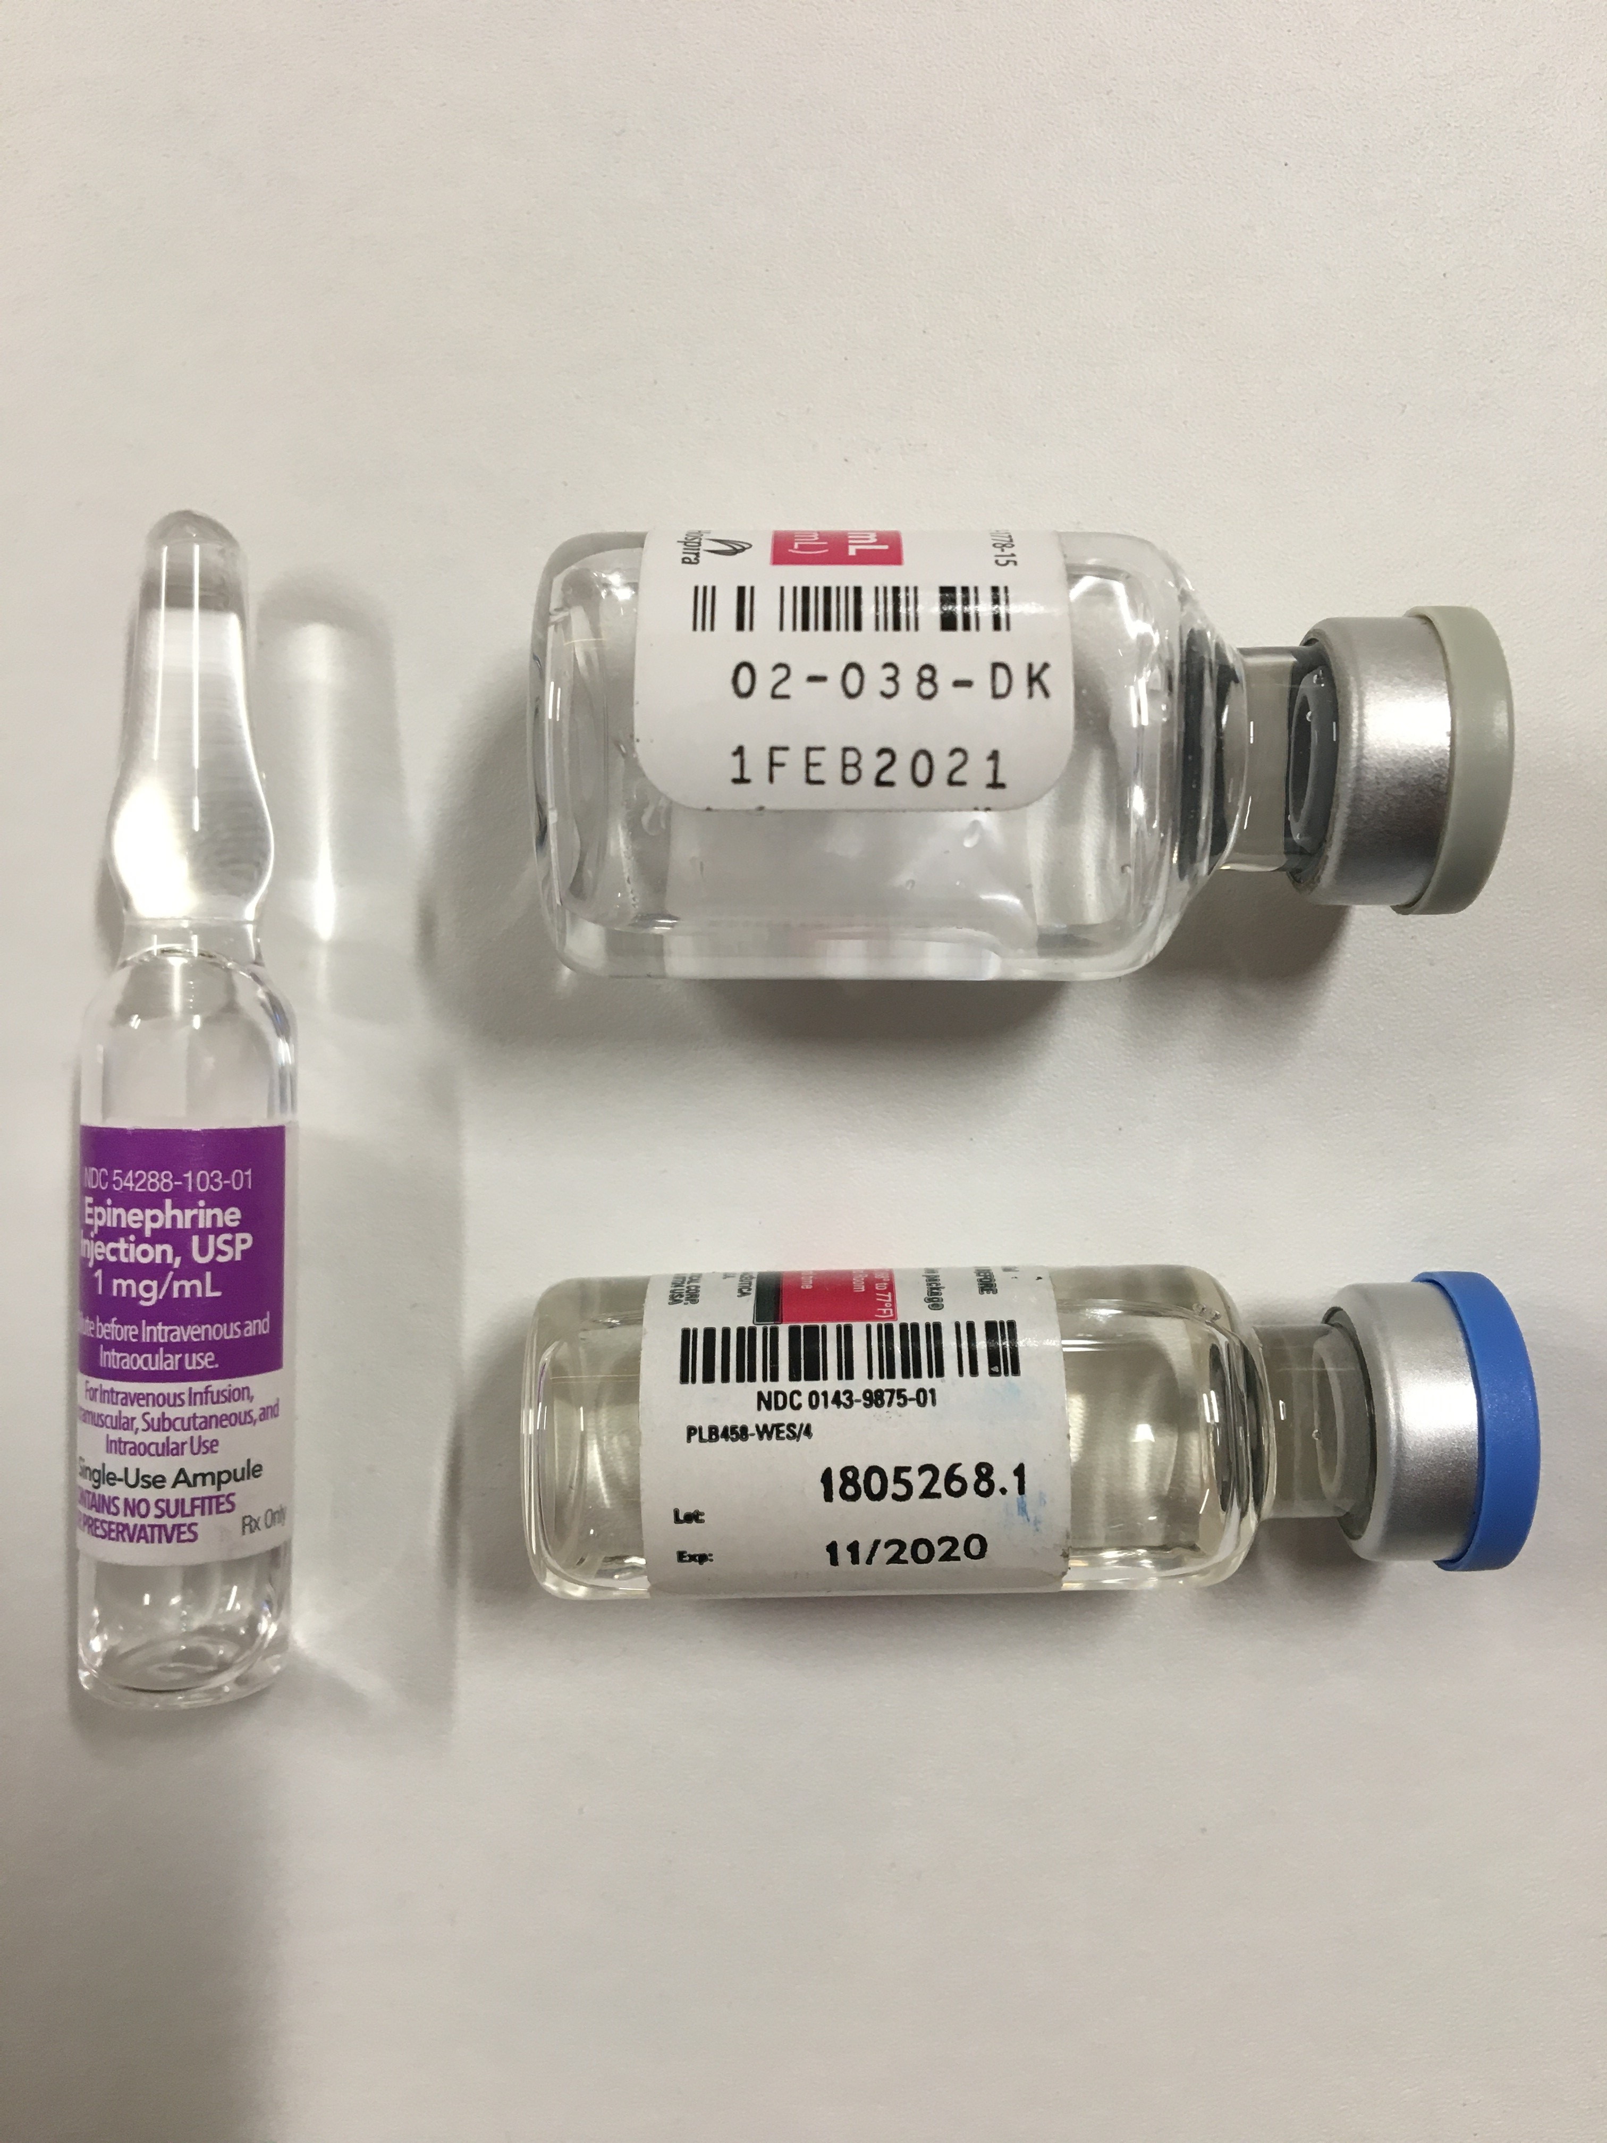
Medication Restocking
Some medications are listed with an expiration date at the end of the month (11/2020) and others at the beginning (1FEB2021).

Slide 17
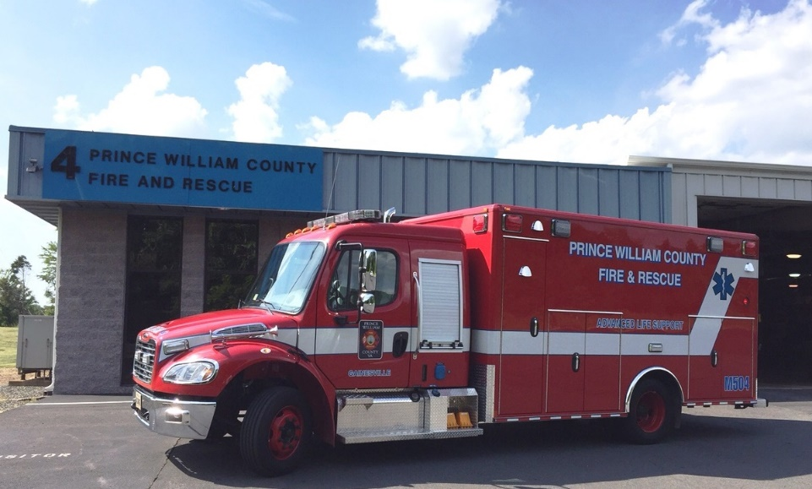
Please use the topics covered here as a starting point for station level discussions on BLS provider roles and expectations. Any questions should be directed to the officer or ALS provider.

