Slide 1
BLS Assist &
Medic Unit Operations
Continuous Positive Airway Pressure (CPAP)

Slide 2
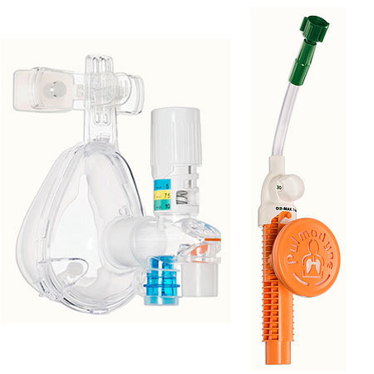
This presentation is part of a series designed to help familiarize PWC BLS providers with medic unit operations. This information will be a refresher for many providers, but consider that experience varies by rank and assignment. It is not intended to be a protocol review or a substitute for in station training. This presentation covers CPAP. Please review the protocol Clinical Procedure: Continuous Positive Airway Pressure (CPAP).

Slide 3
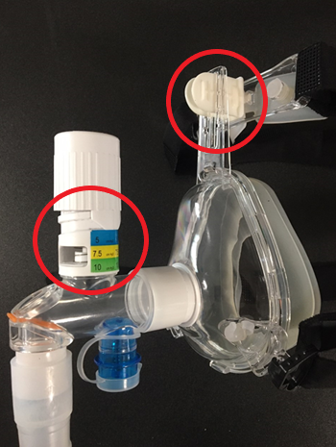
Inspection
Verify the initial PEEP setting of 5cm (BLS cannot titrate).
Verify the adjustment clips aren’t broken.

Slide 4
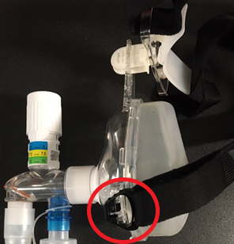
Application
If possible place EtCO2 nasal cannula before CPAP application.
Begin flowing oxygen before attempting to apply the mask / coach the patient.
The mask should be held in place while securing. Use the clips on the bottom of the mask to disconnect/reconnect. Once in place, use the Velcro to tighten.

Slide 5
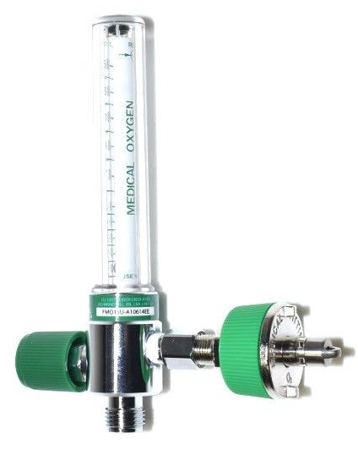
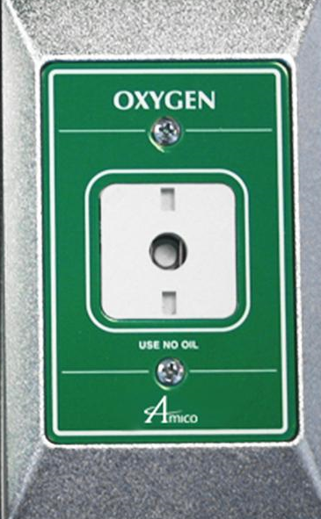
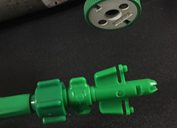
Quick Connection
Oxygen flow regulators inside the patient compartment can be removed to allow CPAP quick connection.
Oxygen switch in patient compartment must be turned on even when regulators are removed.

Slide 6
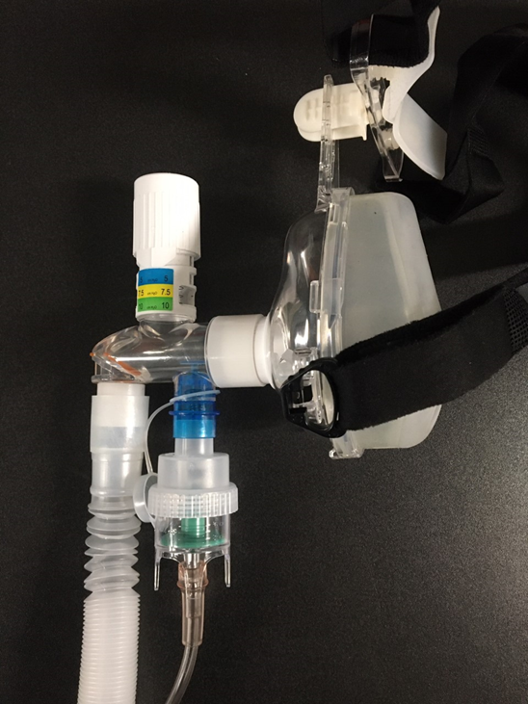
Additional Oxygen Flow
An EtCO2 nasal cannula placed underneath the CPAP mask can be used to increase oxygen delivery.
A nebulizer added to the CPAP circuit will require oxygen flow to aerosolize the medication.
Both examples require their own oxygen tubing / flow in addition to the CPAP.

Slide 7
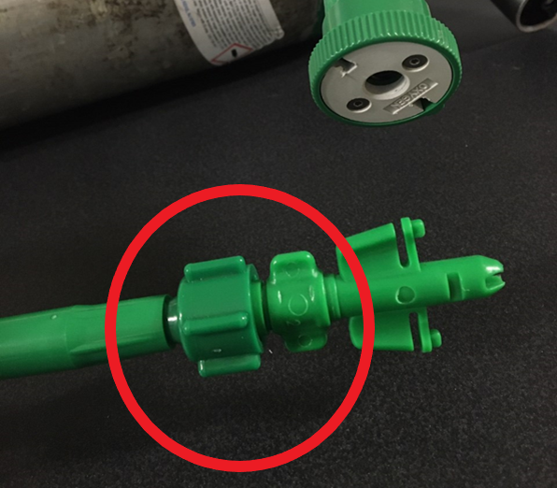
Troubleshooting
Verify that the threaded connection is tight.
Verify that nothing is obstructing the orange filter.

Slide 8
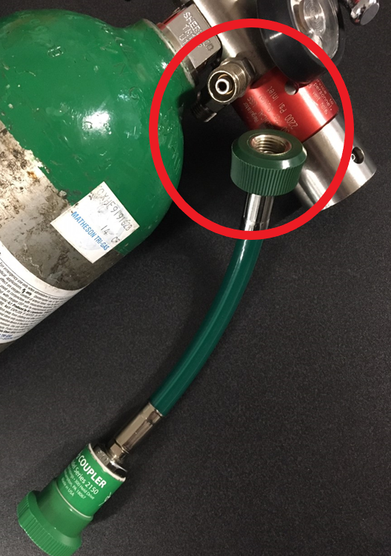
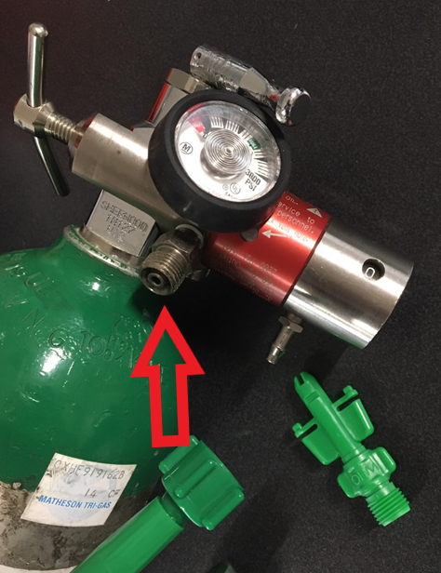
Troubleshooting
The threaded connection can be used instead of quick connect.

Slide 9
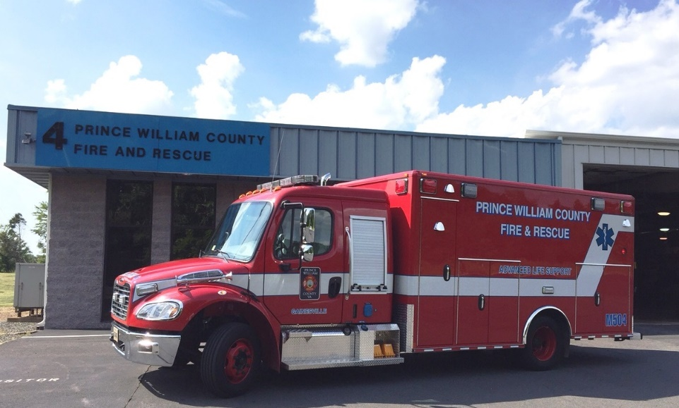
Please use the topics covered here as a starting point for station level discussions on BLS provider roles and expectations. Any questions should be directed to the officer or ALS provider.

