Slide 1
Thoroughfare Community History Project
Department of Parks, Recreation and Tourism
Planning Office
August 31, 2021
Haymarket-Gainesville Library

Slide 2
Tonight’s Agenda
Introductions
Tonight’s Expectations
Project Overview
Main Components of the Project
Timeline and Deliverables
Questions?

Slide 3
Introductions
Department of Parks, Recreation and Tourism Staff
Planning Office Staff
Dovetail Cultural Resource Group Staff

Slide 4
Expectations and Background
Review the Thoroughfare Community History Project – BOCS directed on June 15, 2021
Study Area expanded by BOCS directive on June 15, 2021
Save your questions for the end, questions should focus on just the Thoroughfare Community History Project

Slide 5

The Settlement Recordation Project in Prince William County
Archaeological Assessment including a Prehistoric and Historic Predictive Model of the City of Virginia Beach
Archaeological Survey and Delineation of the Possible Cemetery for Enslaved Individuals at the John Dickinson Plantation
Cultural Resource Study of Buildings and Sites Related to Enslaved Individuals in Stafford County

Slide 6
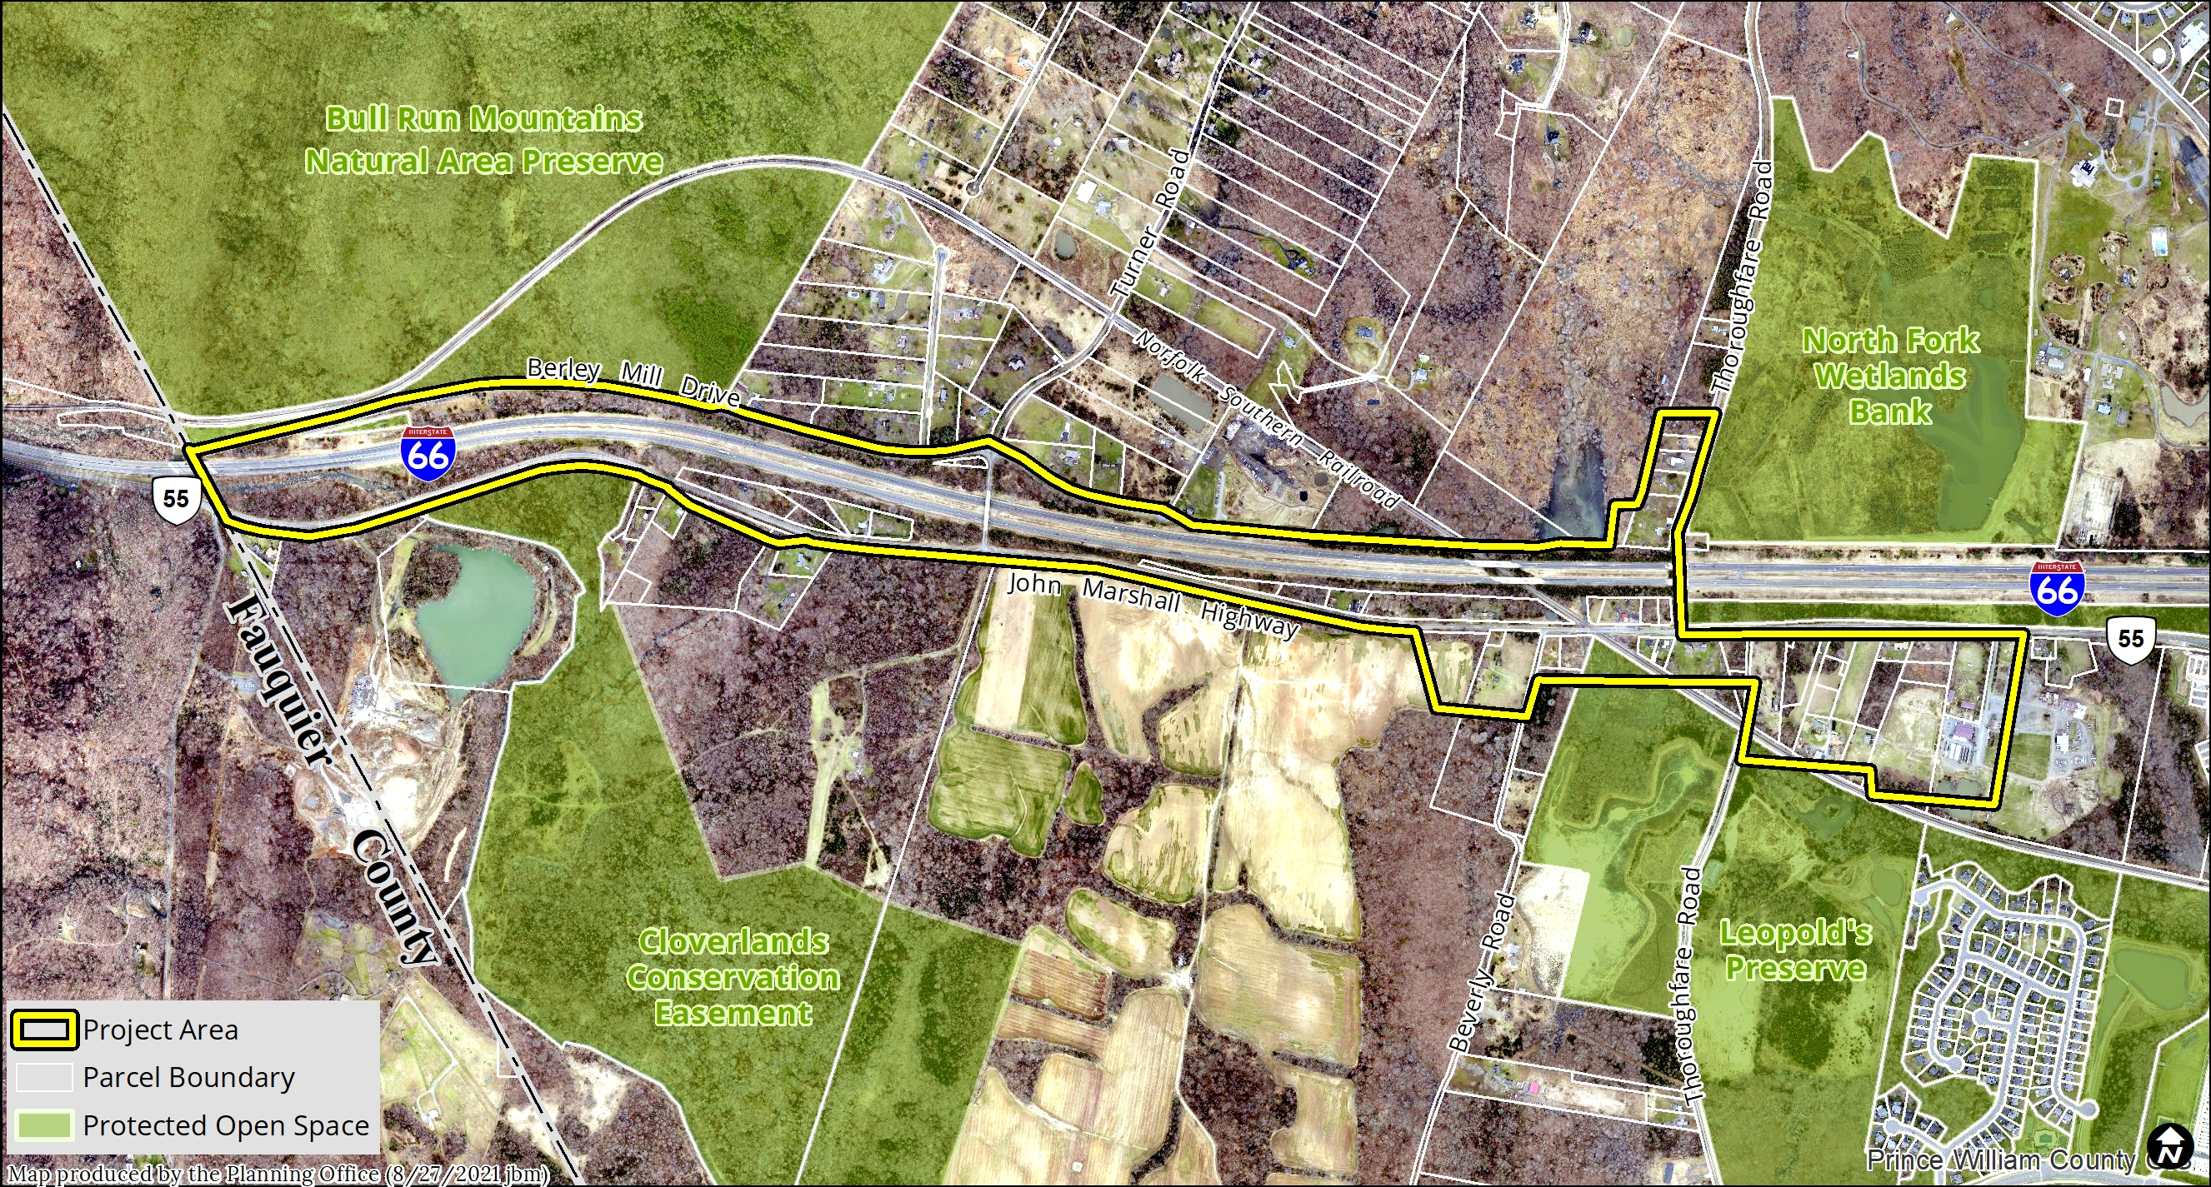
Study Area

Slide 7
Project Overview
- Architectural Survey/Study
- Oral Histories
- Archaeological Assessment
- Preliminary Information Form

Slide 8
Project Timeline
- Architectural Survey – Begins September through October
- Oral Histories – Begins September through November
- Archaeological Assessment – Begins in November through
December
- Prepare Preliminary Information Form – November 2021 through
March 2022 – PUBLIC MEETING ON PROGRESS
- Submit Preliminary Information Forms to Virginia Department of
Historic Resources (VDHR) – April 2022 BOCS PRESENTATION ON
FINDINGS

Slide 9
Project Timeline
- VDHR staff presentation of Preliminary Information Form to the
State Review Board – June 2022
* National Register and Virginia Landmarks Register nomination – Board of County Supervisors decision based off Preliminary Information Forms
* Note: schedule dependent on comments received and other organization’s schedule

Slide 10
Questions?
Stay Informed:
Website: https://www.pwcva.gov/department/parks-recreation-tourism/thoroughfare-community-updates
Email: thoroughfareproject@pwcgov.org
Phone: Rob Orrison at 703-792-5255

