Slide 1
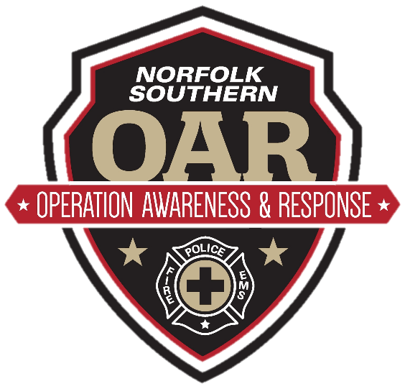
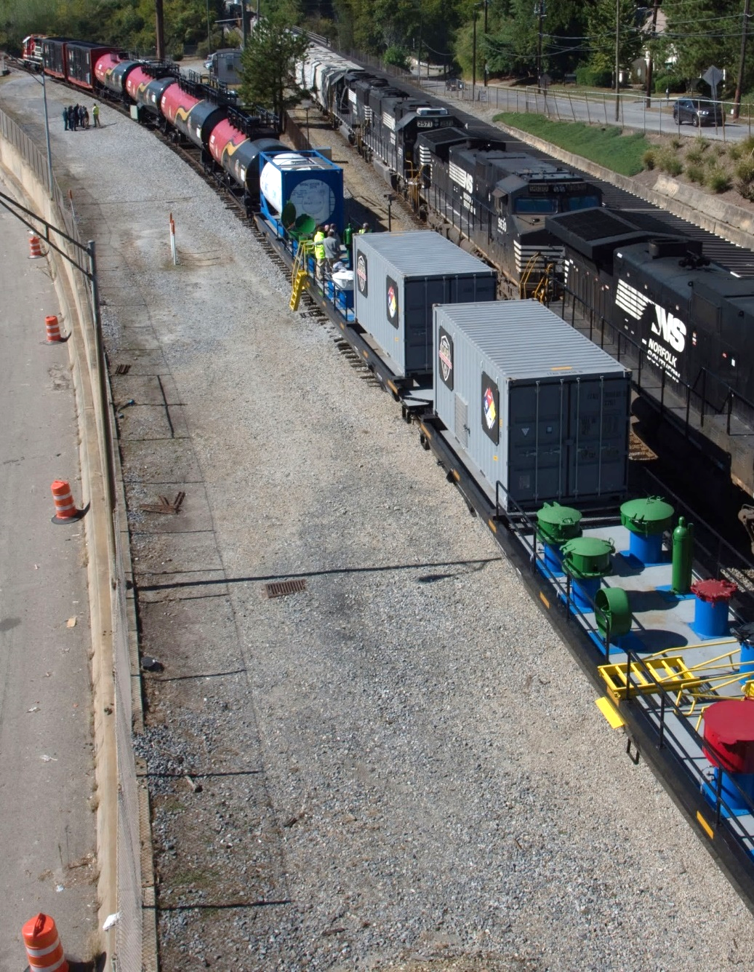
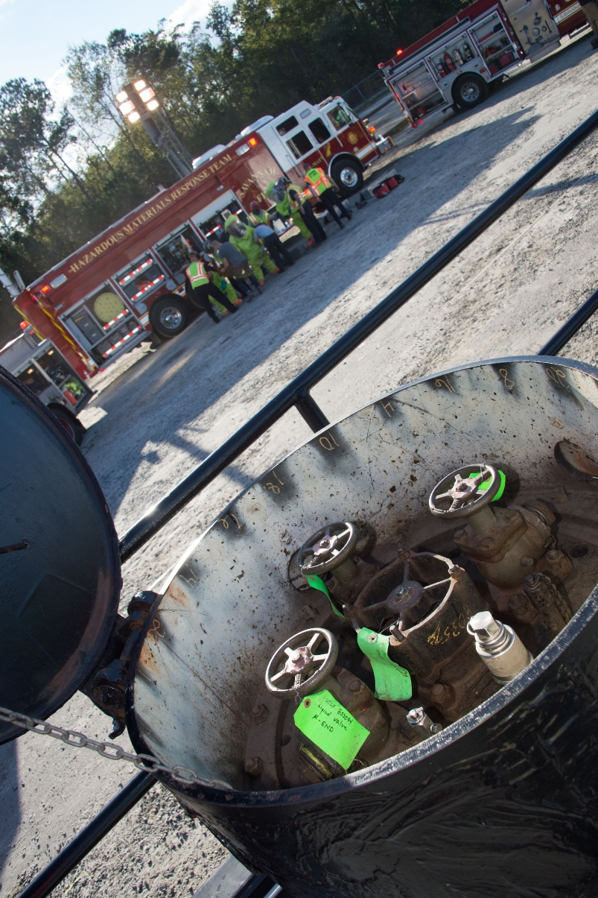
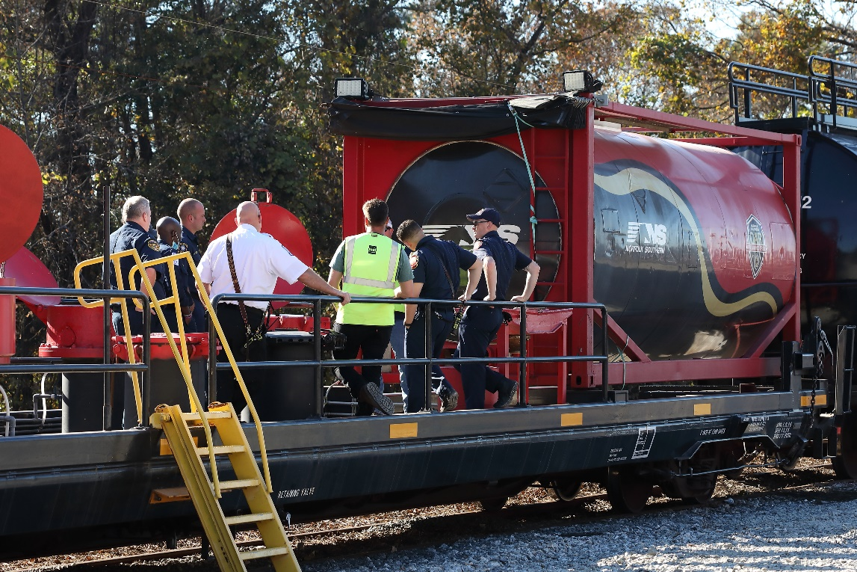
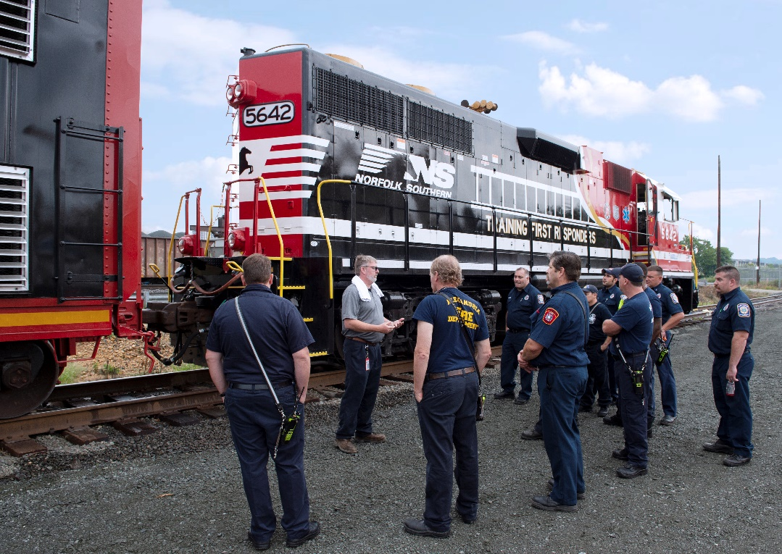
Apr. 30 -
May 2, 2024
Multiple Sessions Tues & Thur.
Railroad 101
Contact – Paul Williams
Paul.williams2@nscorp.com
540-520-8493
Norfolk Southern is coming to town to provide FREE hands-on training with NS’ Safety Train. This free training includes these topics:
Safety Around the Railroad
Understanding Rail Shipping Documents
Rail car & Tank Car Identification
Tank Car Valves & Fittings
Locomotive Emergencies
Railroad Emergencies Procedures
AskRail Mobile App

Slide 2
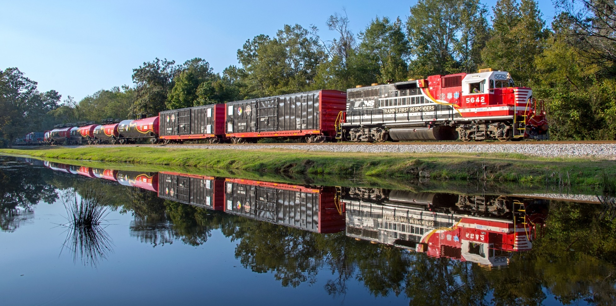
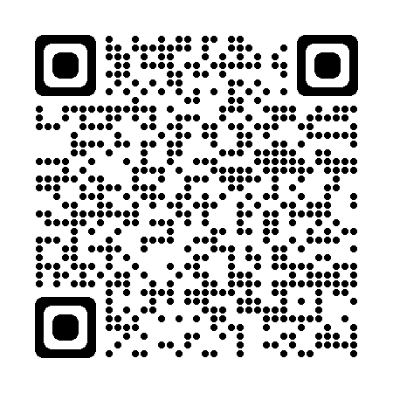
For Event Information
Contact: Paul Williams
Paul.williams2@nscorp.com
540-520-8493
WHO: Emergency responders should attend including fire departments, law enforcement, emergency medical services, hazmat response teams, emergency management personnel, military, homeland security, shippers, & customers
WHAT: Railroad 101 – Two classes per day, Apr. 30 & May 2 – Morning class only May 1
WHEN: Apr. 30- May 2, 2024
WHERE: 1000 South Van Dorn St., Alexandria, VA
REGISTRATION: Register for the RR101 course by going to TRANSCAER | Hazmat Training Events

Slide 3
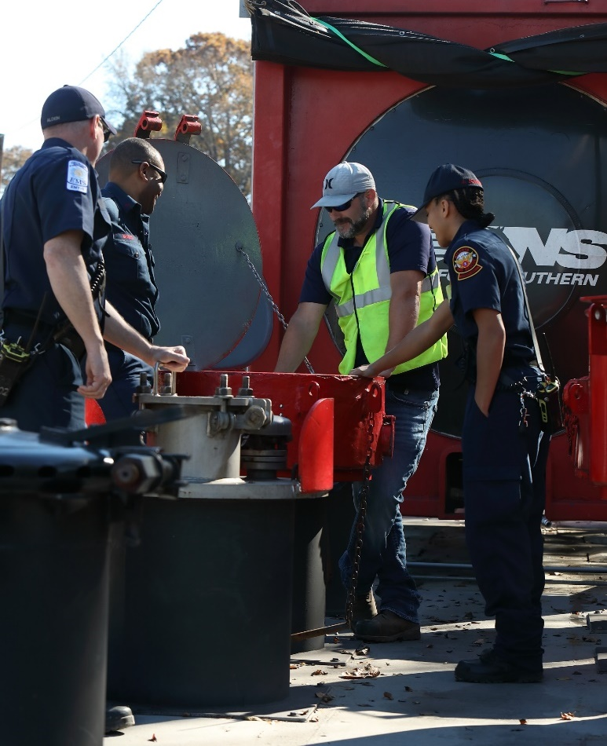
For Event Information or Questions
Contact – Paul Williams
Paul.williams2@nscorp.com
540-520-8493
Participants should bring sturdy leather work boots with a defined heel.
No open-toe footwear permitted.
Bring additional PPE as required by your employer.
Norfolk Southern provides emergency preparedness training to first responders as part of TRANSCAER (Transportation Community Awareness and Emergency Response), a nationwide program that assists communities prepare for and respond to a hazardous materials transportation incident.

Slide 4
Advanced
May 1
2024
Responding To Railroad Emergencies
Contact – Paul Williams
Paul.williams2@nscorp.com
540-520-8493
Norfolk Southern is offering a new course designed to build upon our RR101 introductory training course. The new “Responding to Railroad Emergencies will focus on the below topics and more:
The D.E.C.I.D.E. Process
9 Stages of a Hazmat Emergency
Chemical and Physical Properties
Site Assessment & Safety
Tank Car/Container Assessment
Response Objectives & Tactics
Develop & Execute the Plan
Offensive Tactics
Tank Car Capping Kits
First Responder Mobile Apps

Slide 5
For Event Information
Contact:
Paul Williams
Paul.williams2@nscorp.com
540-520-8493
WHO: This is an advanced class intended for Haz Mat Technicians, command personnel and those that will be required to respond and determine tactics,
resources, and personnel required when responding to a large railroad hazmat
emergency.
WHAT: Responding to Railroad Emergencies
WHEN: May 2, 2024. Class starts daily at 9:00am
WHERE: 1000 Van Dorn St., Alexandria, VA
REGISTRATION: Register for this advanced course by going to TRANSCAER | Hazmat Training Events

Slide 6
For Event Information or Questions
Contact: Paul Williams
Paul.williams2@nscorp.com
540-520-8493
Participants should bring sturdy leather work boots with a defined heel.
No open-toe footwear permitted.
Bring additional PPE as required by your employer.
Norfolk Southern provides emergency preparedness training to first responders as part of TRANSCAER (Transportation Community Awareness and Emergency Response), a nationwide program that assists communities prepare for and respond to a hazardous materials transportation incident.

