Slide 1
WELCOME!
1
2
3
Collect Nametag and Priority Dots.
(Choose the color of the group you most identify with)
Grab a Seat at one of the four tables. We will begin shortly!
Place dots on your priorities for each facility type on the posters in the back of the room.

Slide 2
Countywide Trails Master Plan Update Trails Planning Charrette
Notes:
Welcome!
Tonight is the public kickoff for the update to the Countywide Trails Master Plan
We’ve got a full agenda

Slide 3
Tonight’s Agenda
Sign-In
Introduction/Overview
Mapping Exercise
Next Steps
Map Review
Priority Exercise
“Help Us” Exercise
Notes:
You should have gotten a nametag and some colored dots when you came in, and gone through our prioritization exercise in the back posters
After giving a brief overview of tonight and the larger project we’ll break out the maps and let you do some drawing
Then we’ll come back together to discuss what we’ve learned and any observations from your groups
We’ll discuss next steps and then give you one more opportunity for feedback as you leave

Slide 4
County Staff Team
Department of Parks and Recreation
Patti Pakkala, Planning Manager
Robert Boyd, Principal Planner
David Kroeger, Planner
Katherine Gonzalez, GIS Analyst
PWC Department of Transportation
Bryce Barrett, Principal Planner/Bike and Ped Coordinator
Department of Planning
Yolanda Hipski, Senior Planner

Slide 5
Why Update the Plan?
It’s been 32 years since the Park Authority introduced the Trails and Greenways Master Plan
Trails were reviewed as part of Parks Chapter in 2008. Moved to Mobility Chapter with update in 2022.
Development of the plan is directed by the 2040 Comprehensive Plan
(Mobility Chapter Strategy RT9.2)
Notes:
Original Plan approved in 1993 focused on greenways
Staff capacity lacking
Efforts have progressed, but plan is needed to unify vision
Technology, best practices, goals, etc have all changed
Directed by Mobility Chapter to create a new plan
RT9.2 Develop a County-wide Trails Master Plan that identifies trail and active mobility gaps and includes priorities for inclusion into capital improvement and capital maintenance budgets. In support of action strategy REC 1.6 (Parks, Recreation and Tourism Chapter) include an evaluation of blueway opportunities and interjurisdictional connections, as well as an analysis of bicycle routes and equestrian trails. This plan should be updated every 10 years following the update to the Parks, Recreation and Open Space Master Plan

Slide 6
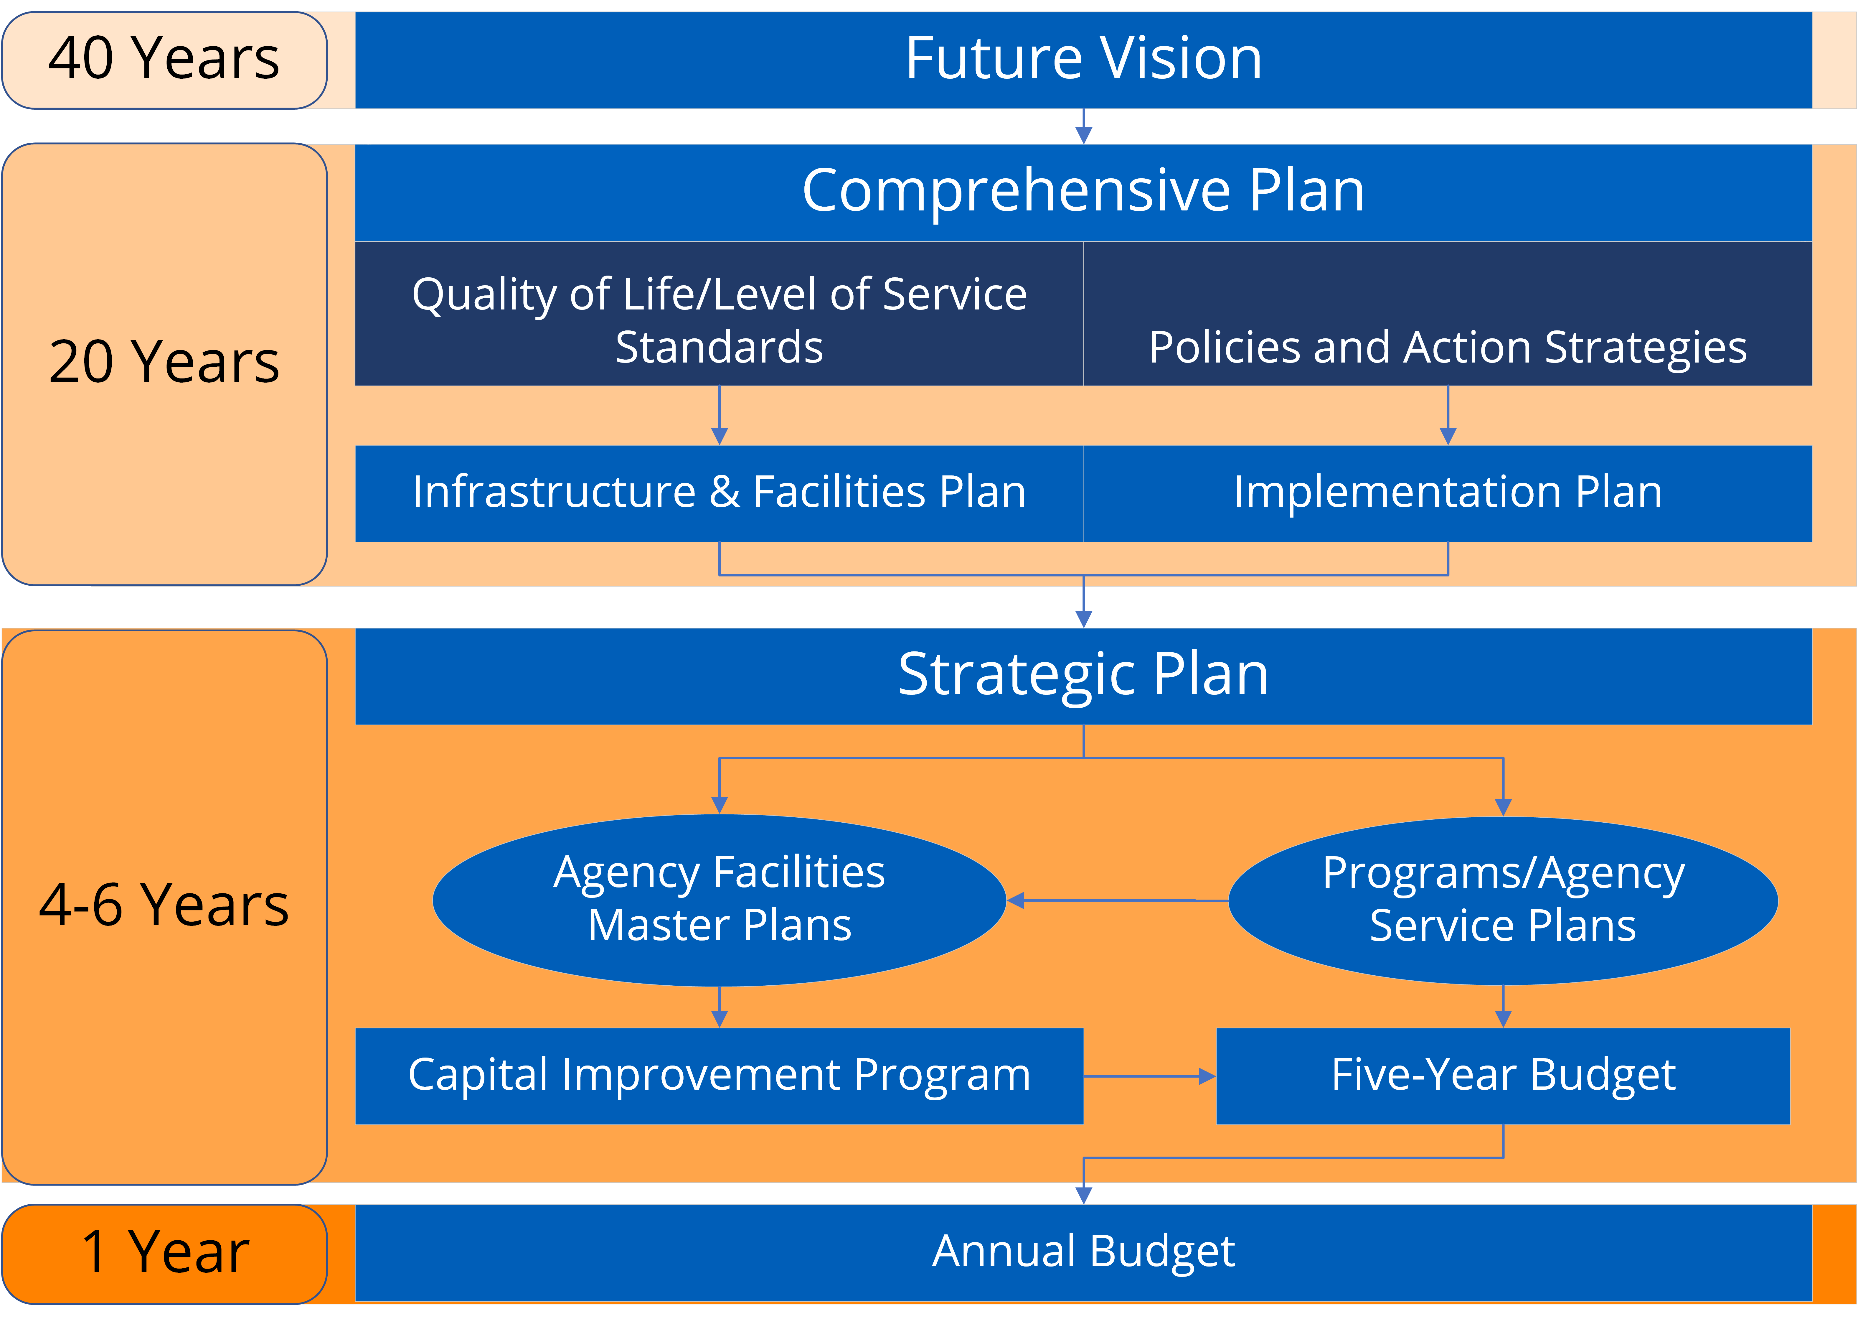
The Role of the Countywide Trails Master Plan
10-year Horizon
Offset from 10-year Parks, Rec, and Open Space Master Plan
Allows for input from the Needs Assessment and Strategic Plans
Feeds scheduled Comp Plan updates, as well as CIP, PROS MP, and budgets
Notes:
Intended to be a more detailed look that works within the comp plan timeline
Updates are timed to allow input from outreach and planning documents and also feed budgetary efforts
CIP/CMP

Slide 7
Project Timeline
Notes:
Wrapping up data collection
Moving into a phase of feedback review and creating a draft report
We will be coming back for additional outreach opportunities in the fall, and are also developing an online survey for the summer
We look to present this for board adoption in January 2026

Slide 8
Goals for Tonight’s Meeting
Identify Priorities
Where are trails needed/most beneficial?
Draw and Discuss
Where are the key connections to create a robust public trail network?
Learn
What is currently planned? What are the next steps?
Notes:
Moving onto the focus for tonight,
You’ve already provided some of your priorities through the dot exercise
The mapping exercises will hopefully foster discussion among the groups on what connections should be made
We want you to learn about our planning efforts and how we move this project forwards

Slide 9
Goals for Tonight’s Meeting
Have Fun!

Slide 10
How do We Design Trails?
Trail:
A facility designed for human-powered mobility or recreation
Active Mobility Trails
Recreational Trails
Trails outside of the road Right-of-Way. Primarily designed for leisure and enjoyment.
(Includes Greenway and Blueway corridors)
Trails within the road Right-of-Way. Primarily designed for efficiency of transportation.

Slide 11
How do People Use Trails?
Trails
Network Connectivity
Recreational Trails
Active Mobility Trails
User Experience
Notes:
Top Priorities at the end

Slide 12
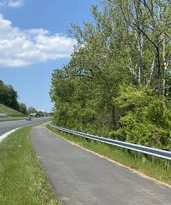
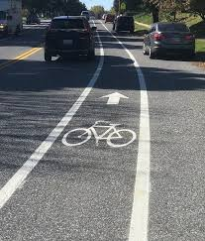
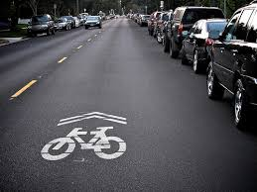
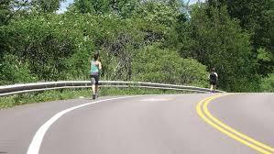
Mapping Exercise: Active Mobility Trails
Active Mobility Trails
Trails within the road Right-of-Way. Primarily designed for efficiency of transportation.
Shared Use Path
Bike Lane
Sharrow
Paved Shoulder
Notes:
Not as the crow flies

Slide 13
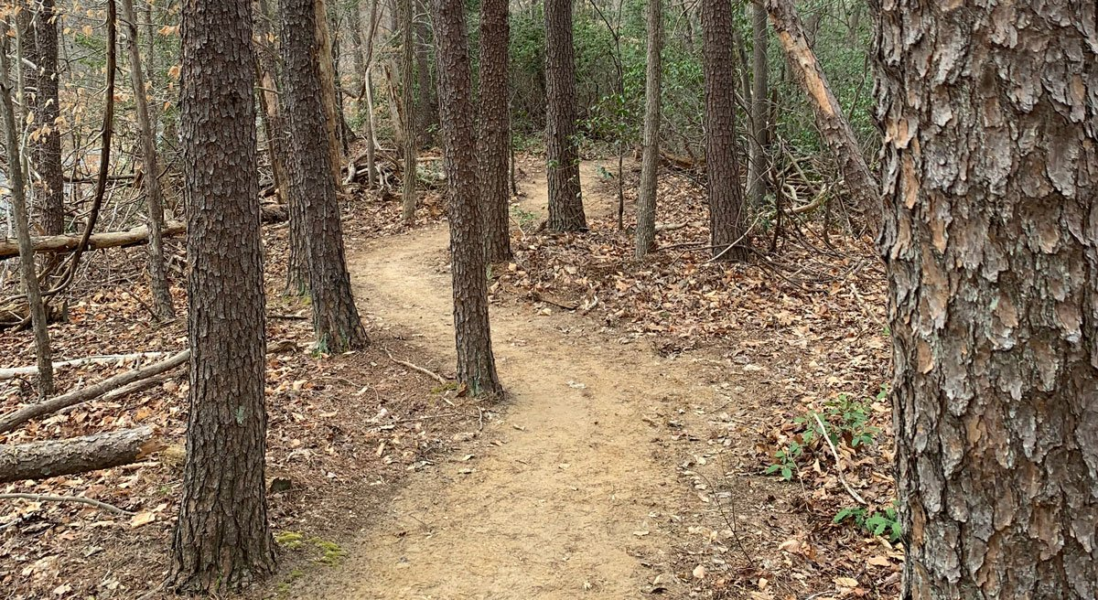
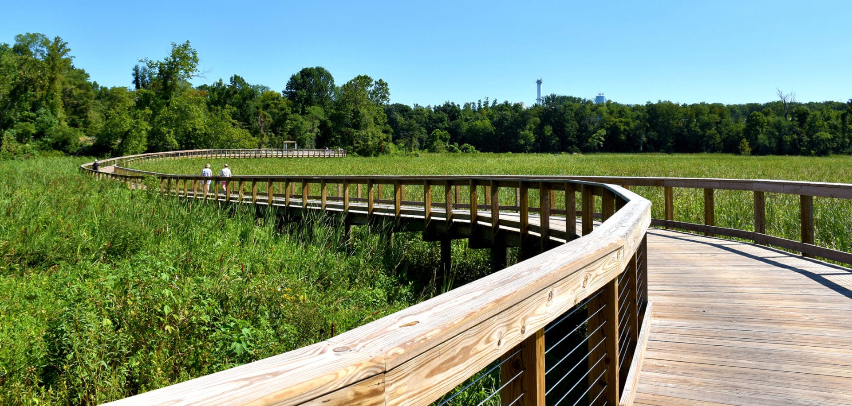
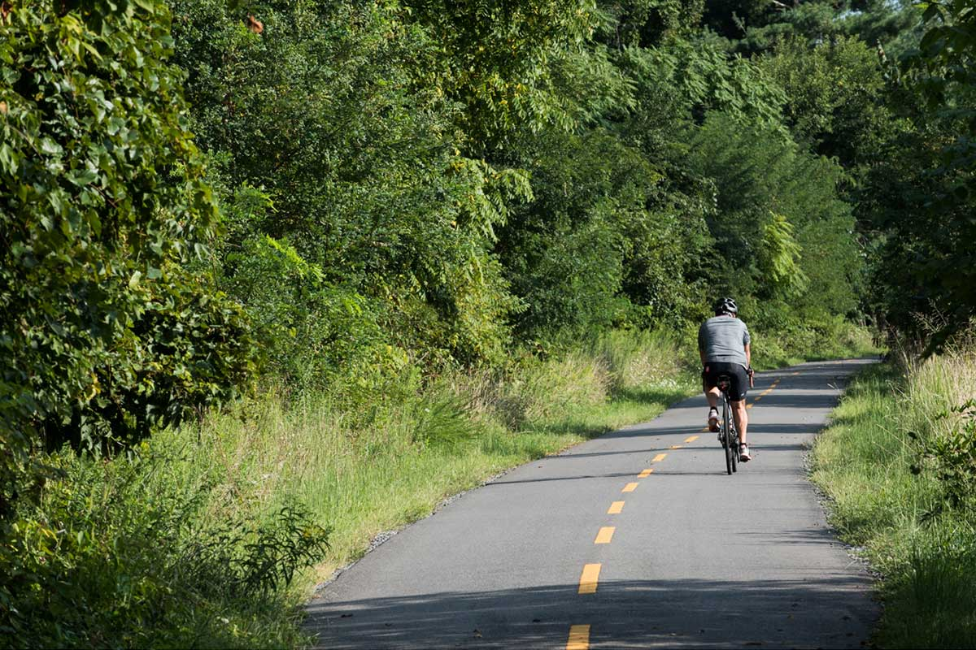
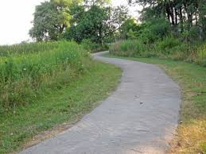
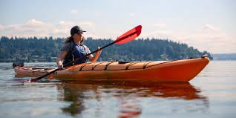
Mapping Exercise: Recreational Trails
Recreational Trails
Trails outside of the road Right-of-Way. Primarily designed for leisure and enjoyment
Singletrack Trail
Boardwalk
Paved Trail
Blueways
Improved Surface Trail
Notes:
Not as the crow flies
Add Blueways
Majority of the trails are multi-use

Slide 14
Goals for the Plan
Full Network Map Review
Notes:
2 main goals
Identify planned gaps
Also correct any errors
Create prioritized list
Could be short, feedback will inform
Emphasis on active transportation and rec trails
Major data collection effort
In the field
Desk review
Create new maps for each topic
Cost Estimation
Still a little unsure what shape this will take
Could be blanket estimate based on surface type and mileage
Could be more specific on a shorter list of projects
Will NOT
Identify sidewalk gaps (AT1.2)
Directly update the Comprehensive Plan (more later)

Slide 15
Full Network Review
82 Miles
of existing Recreational Trails
5
Existing Launches
123 Miles
of existing Active Mobility Trails
125 Miles
Planned and Proposed
14
Planned and Proposed Launches
291 Miles
Planned and Proposed
207 Miles
19 Launches
414 Miles
At full build out
Notes:
Existing network – 205 miles total
416 - planned and proposed miles
152% increase for rec trails, 236% increase in active mobility
For rec trails – 70 miles are “planned” could build them tomorrow with enough funding
Highlights the importance of prioritizing the trail segments already on the map
Our goal is to get closer to construction

Slide 16
Goals for the Countywide Trails Master Plan
Identify Gaps
Where are the planned and proposed segments on the map?
Prioritize Gaps
Which segments should be funded first?
Update and Evaluate
Trail Mileage
Blueways
Interjurisdictional Connections
Bicycle Routes
Equestrian Trails
Cost Estimation
Develop high level cost estimates for surface types and potentially individual projects
(CIP)
Maintenance Needs
Identify maintenance costs/projects to feed the CMP
(CMP)
Notes:
2 main goals
Identify planned gaps
Also correct any errors
Create prioritized list
Could be short, feedback will inform
Emphasis on active transportation and rec trails
Major data collection effort
In the field
Desk review
Create new maps for each topic
Cost Estimation
Still a little unsure what shape this will take
Could be blanket estimate based on surface type and mileage
Could be more specific on a shorter list of projects
Will NOT
Identify sidewalk gaps (AT1.2)
Directly update the Comprehensive Plan (more later)

Slide 17
Final Questions
Stay Informed
Use sticky notes to “Help Us”
Please provide feedback to questions on the back wall
Project Webpage
Thanks for Coming!
?
Send Feedback to
trails@pwcgov.org

