Slide 1

Office of Sustainability Quarterly Update
April 2026

Slide 2

Agenda
Office of Sustainability Updates
Updates on Implementing County Plans
Strategic Plan
CESMP
Annual Report and Government Operations GHG Inventory

Slide 3
Implementing County Plans
Sustainability Updates
Annual Report & Gov Ops GHG Inventory

Slide 4

VISION
Meet our community’s needs today without compromising the quality of life or availability of resources for future generations.
MISSION
Strategically integrate environmental sustainability county-wide and in county government operations to meet our transforming community needs now and in the future.
Integrating sustainability into department operations/projects by:
Building staff capacity for sustainability initiatives.
Aligning the County’s sustainability actions—ensuring that the impacts and progress on meeting the County’s goals are measured and highlighted.
Applying for grant funding and technical support through federal, state, or other programs.

Slide 5
Updates about Staff Capacity
Welcomed Kevin Milsted to the Sustainability Team as our New Green Buildings Manager!
Residential and commercial building emissions together are the largest contributor to PWC’s GHG emissions.
This position will work to identify and implement energy efficiency and renewable energy measures to reduce GHGs from County government and county-wide buildings.
Reviewing Applications for Climate Risk & Resilience Manager
This position will provide the expertise needed to strategically protect the County's assets, including socially vulnerable populations and natural resources, from increasingly intense climate hazards.

Slide 6
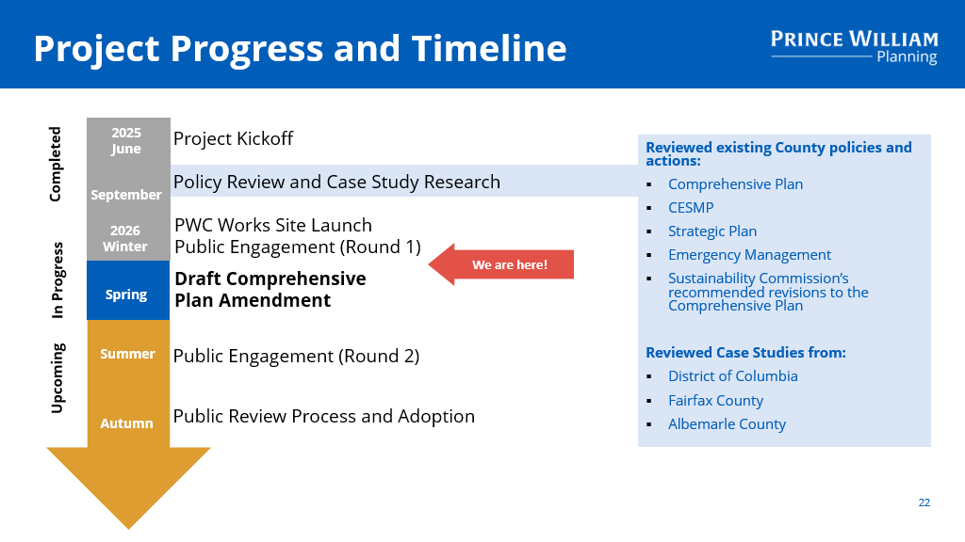
Updates about Aligning the County’s Sustainability Actions
Coordinating with the Planning Office and Emergency Management on the Comprehensive Plan Amendment (CPA) to incorporate the CESMP and resilience into the Comprehensive Plan
Hosted 3 Public Meetings
Online Public Survey closed March 18th

Slide 7
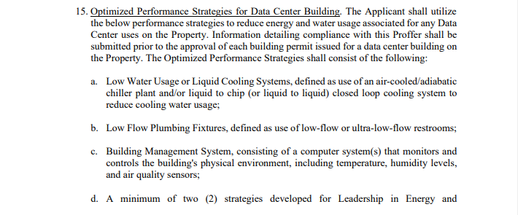

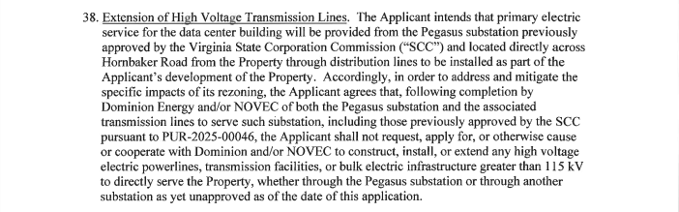
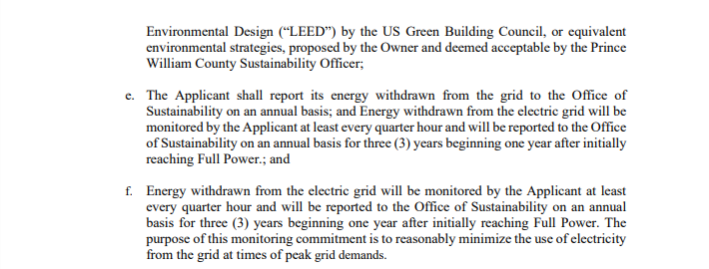
Data Center Proffers
Innovation on the Parkway
(BOCS approved on October 28, 2005)
Hornbaker Road
(BOCS approved on March 3, 2026)
7

Slide 8
Data Center Proffers (Cont’d)
Planning Office Comment Letter to the Six Towers Industrial Park applicant (April 1, 2026)
Please ensure that proposed measures have clear triggers, checks, measurements, and/or procedures for enforcement.
Please avoid including what is standard industry practice as potential options.
Please ensure that sustainability measures are proportionate to the impacts of the development and use.
It is preferable to have more certainty regarding what measures will be used, instead of a general commitment of 8 measures out of a list of 21.
For proffer 34m, it is recommended to include further details regarding feasibility analysis, and reaching out to surrounding properties, especially the school, regarding sharing heat.
For proffer 34p, it is recommended to lower the number to an annualized 1.2 or lower PUE, the recognized benchmark for high-performance data centers
For proffer 34r, it is recommended to expand this to the data center portion of the building.
For proffer 34s, it is recommended to include language that the generators would be Tier-4 compliant as defined by the applicable United State Environmental Protection Agency and Virginia Department of Environmental Quality standards and regulations.
It is encouraged to still include sustainability measures if no data center building is built.

Slide 9

Updates about Aligning the County’s Sustainability Actions (continued)
Leading the Strategic Plan Environment Goal efforts
Final Work Plans submitted January 9th
Key Performance Indicator (KPI) Workshop held on March 13th
Updated leadership on progress on April 14th

Slide 10



Outside Support Updates
Solarize 2026 Campaign (April 15 - July 15, 2026)
PJM Cities and Communities Coalition (CCC): Coalition of localities advocating for reducing grid carbon emissions.
Charging Smart: Program for community EV charging readiness
Program was paused and has recently restarted
U.S. Green Building Council (USGBC) Local Green Building Policy Accelerator
ICLEI: The world’s largest network of local and regional governments focused on sustainability, climate resilience and equity
Prince William County joined as member in December 2025

Slide 11
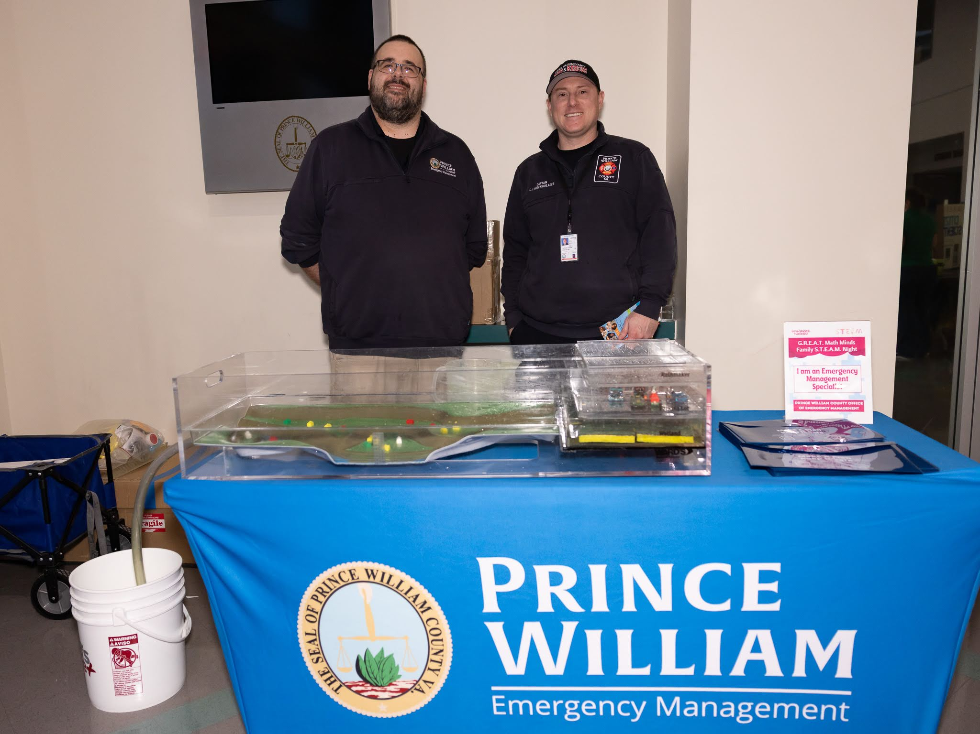
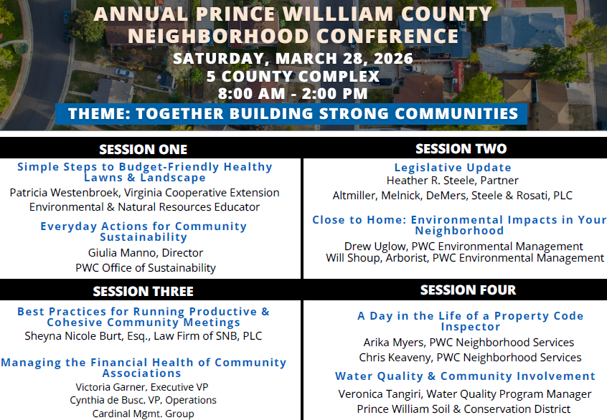

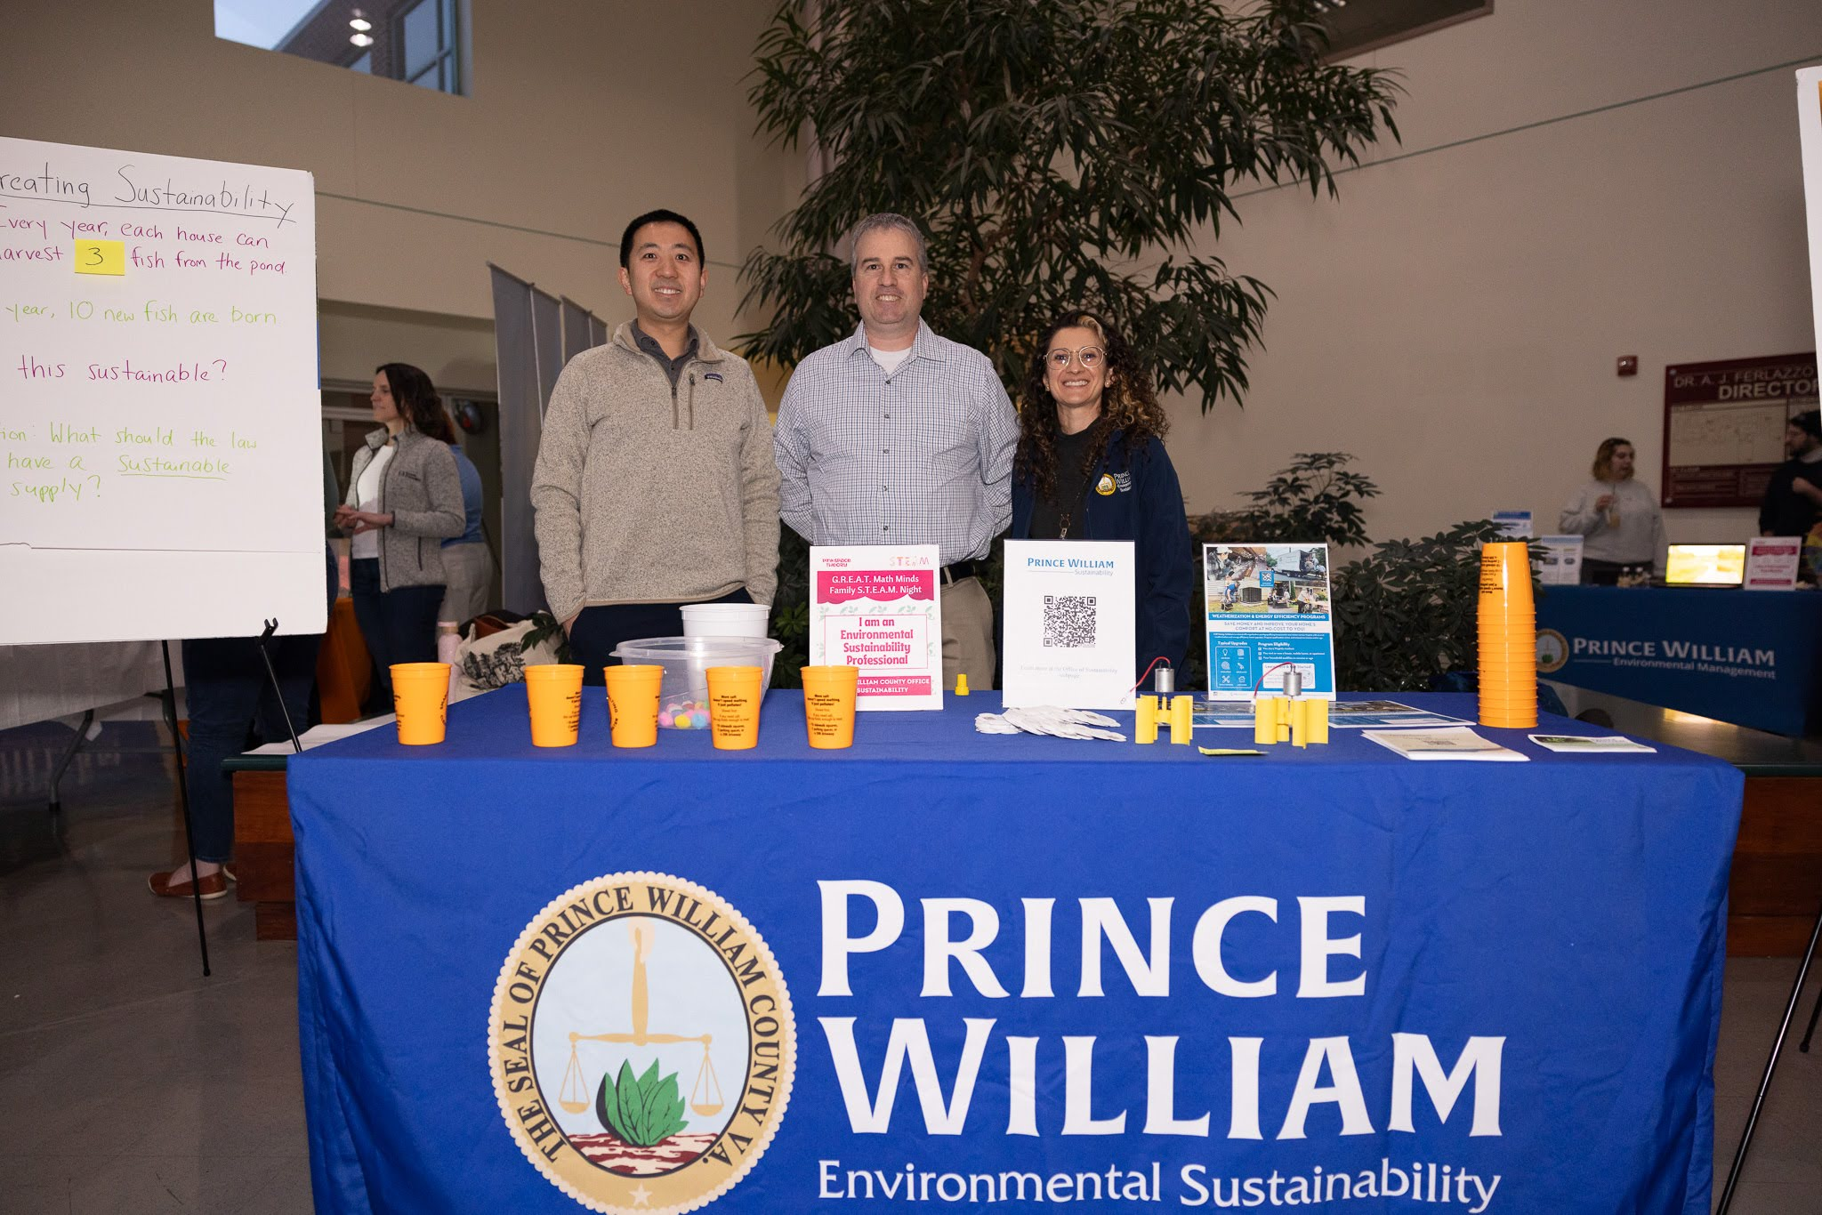
Recent Events
Pink Space Theory – Community Microgrant Awardee
Neighborhood Conference
Pink Space Theory, with support from Joint Environmental Taskforce, hosted STEAM Event "“G.R.E.A.T. Math Minds Sustainability Matters”
Over 100 students and family members from Featherstone, Neabsco, and Loch Lomond Elementary Schools participated
Supported by 19 organizations showcasing sustainability careers

Slide 12


Upcoming Events
Saturday, April 25, 2026
10 a.m. - 3 p.m.

Slide 13
Sustainability Updates
Implementing County Plans
Annual Report & Gov Ops GHG Inventory

Slide 14
Environmental Sustainability Workgroup (ESW) Meets Quarterly
Cooperative Extension (VCE)
Department of Fire & Rescue
Department of Public Works (DPW)
Department of Transportation (DOT)
Development Services (DDS)
Economic Development
Facilities and Fleet Management (FFM)
Finance – Risk & Wellness (Risk)
Housing
Libraries
Office of Emergency Management (EM)
Office of Equity and Inclusion
Office of Management and Budget (OMB)
Office of Sustainability (OoS)
Department of Parks and Recreation (DPR)
Planning Office (Planning)
Prince William Soil & Water Conservation District (PWSWCD)
Procurement
PWC Schools (PWCS)
Transformation Management Office (TMO)
Virginia Department of Health (VDH)
Brief departments on the Office of Sustainability’s efforts
Share progress on CESMP, Strategic Plan, and other sustainability actions
Highlight successes & discuss challenges
Identify areas for collaboration

Slide 15
Strategic Plan Environment Goal Objectives
Safeguard natural resources
Safeguard the quality of the County’s air, water, and other natural resources to ensure they are not compromised for the current and future generations.
Enhance green spaces
Enhance and expand public parks, trails, and green spaces to improve accessibility.
Use the CESMP and Comp Plan to meet climate goals
Utilize the CESMP and Comprehensive Plan to guide decision-making and encourage leadership, businesses, and residents to help the Board achieve climate mitigation and resiliency goals.
Expand renewable energy sources
Support and incentivize the development and use of renewable energy sources to reduce impacts on air quality and the environment.
Reduce and mitigate flooding
Reduce and mitigate the impacts of flooding in communities.
1
2
3
4
5

Slide 16
Obj. 1: Safeguard natural resources
Existing Projects
New Projects
Project | Lead Department(s) | FY26 Tasks Status
Green Zoning | Planning | On Track
Expansion of Reforestation Program | DPW: County Arborist DPR | On Track
Water Quality Programs | PWSWCD DPR | On Track
Education and Community Engagement Programs | PWSWCD VDH VCE | On Track
Project | Lead Department(s) | FY26 Tasks Status
PPEA Proposal | DPR | On Track
Parks & Recreation summer camps and resident education | PWSWCD VCE | On Track
Salt education program expansion | Risk PWSWCD | On Track
Interdepartmental coordination | OoS | Completed
Invasive plants management staff training | VCE and DPR | Delayed

Slide 17
Obj. 2: Enhance green spaces
Existing Projects
New Projects
Project | Lead Department(s) | FY26 Tasks Status
County Trail Improvement | DOT DPR | On Track
Park Quality Improvement | DPR | On Track
Parkland Acquisition | DPR DPW | On Track
Developing Small Area Plans (SAPs) | Planning | On Track
Trails & Blueways Council | Planning | On Track
Transportation Safety Plan and Connectivity | DOT | On Track
Project | Lead Department(s) | FY26 Tasks Status
Bike and Pedestrian Gap Analysis | DOT | On Track

Slide 18
Obj. 3: Use the CESMP and Comp Plan to meet climate goals
Existing Projects
New Projects
Project | Lead Department(s) | FY26 Tasks Status
Sustainability and Resilience CPA | Planning | On Track
Green Zoning | Planning DOT | On Track
Develop outreach material | OoS | On Track
Project | Lead Department(s) | FY26 Tasks Status
Presenting at Neighborhood Conference | OoS | Completed
Engage the Business Community | OoS | On Track
Exploring Virginia Green Certification | OoS | On Track
Outreach and Communications Manager | OoS | On Track

Slide 19
Obj. 4: Expand renewable energy sources
Existing Projects
New Projects
Project | Lead Department(s) | FY26 Tasks Status
Green Zoning | Planning DOT | On Track
Sustainable Buildings | FFM | At Risk
EV Transition | FFM | At Risk
JET – School Collaboration | OoS | On Track
Renewable Natural Gas Plant | DPW | On Track
Energy and Emissions Data and Bill Payment | OoS FFM | On Track
Project | Lead Department(s) | FY26 Tasks Status
Exploring Sustainable Buildings Program/Fund | OoS FFM | Delayed
Exploring ESPC | OoS | On Track
EV Cost Benefit Analysis and Direct Pay | OoS Procurement | On Track
Equipment for Park Maintenance | DPR | On Track
Exploring VPPA | OoS | Delayed

Slide 20
Obj. 5: Reduce and mitigate flooding
Existing Projects
New Projects
Project | Lead Department(s) | FY26 Tasks Status
Hiring/onboarding Climate Risk & Resilience Manager | OoS | On Track
Addressing Flood Prone Areas | DPW DPR | On Track
Flood Watch List | DPW | On Track
Community Rating System (CRS) | DPW | On Track
Flood Mitigation Planning | EM | On Track
Facilitate Hazard Mitigation Program | EM | On Track
Sustainability and Resilience CPA | Planning | On Track
Implementation of Green Infrastructure Study | DOT | On Track
Project | Lead Department(s) | FY26 Tasks Status
Alternate Funding Strategies | EM | On Track
Staff Capacity | EM | Delayed
Homeowner Education | DPW | On Track
Requesting Outreach and Communications Manager | OoS | On Track
Stormwater Management Grant Program | DPW | On Track
Mitigation Actions to Prevent Damage to Public Facilities | DPR | On Track

Slide 21
Community Energy & Sustainability Master Plan (CESMP) 25 Priority Actions
E.1. Acquire Clean Electricity Sources for the County
E.2. Promote Renewable Energy Incentive Programs and Develop Additional Solar Incentives
E.3. Encourage Renewable Energy Use in Energy-Intensive Commercial Buildings
E.4. Promote Existing Green Power Products
E.5. Install Solar on County Government Facilities
B.1. Encourage Energy Efficiency and Electrification Retrofits
B.2. Propose Green Zoning Regulations
B.3. Encourage Energy Efficient and Electric New Construction
B.4. Promote Energy Efficiency and Electrification Incentives
B.5. Transition to Net-Zero County Government Facilities
T.1. Improve Pedestrian and Bicycle Infrastructure and Enhance Connectivity
T.2. Encourage Transit-Orientated Development
T.3. Expand Existing Programs that Reduce Single-Occupancy Vehicle Trips
T.4. Upgrade Public Transit Infrastructure
T.5. Encourage Zero-Emission Vehicles and Charging
T.6. Expand Public EV Charging Network
T.7. Adopt Zero- or Low-Emissions County Fleet
N.1. Adopt Natural Open Space Requirements
A.1. Develop Adaptation Plans for Critical Facilities
A.2. Manage Stormwater Flooding Outside of the Floodplain
A.3. Improve Power Resiliency for Critical Infrastructure
A.4. Assess Shoreline Protection and Nature-Based Solutions
A.5. Restore Streams to Reduce Flooding
A.6. Encourage Technology for Residents to Make Homes Adaptive
A.7. Plan Alternate Evacuation Routes for Flood-prone Areas
Energy
Buildings
Transportation
Natural Resources
Adaptation

Slide 22
CESMP: Energy
Action No. | CESMP Action | Department(s) | Status
E.1 | Acquire Clean Electricity Sources for the County | OoS | In Progress
E.2 | Promote Renewable Energy Incentive Programs and Develop Additional Solar Incentives | OoS | Completed - Continuous
E.3 | Encourage Renewable Energy Use in Energy-Intensive Commercial Buildings | OoS | In Progress
E.4 | Promote Existing Green Power Products | OoS | In Progress
E.5 | Install Solar on County Government Facilities | FFM | In Progress

Slide 23
CESMP: Buildings
Action No. | CESMP Action | Department(s) | Status
B.1 | Encourage Energy Efficiency and Electrification Retrofits | OoS | Not Started
B.2 | Propose Green Zoning Regulations | Planning | In Progress
B.3 | Encourage Energy Efficient and Electric New Construction | OoS | In Progress
B.4 | Promote Energy Efficiency and Electrification Incentives | OoS | Completed - Continuous
B.5 | Transition to Net-Zero County Government Facilities | FFM | In Progress

Slide 24
CESMP: Transportation
Action No. | CESMP Action | Department(s) | Status
T.1 | Improve Pedestrian and Bicycle Infrastructure and Enhance Connectivity | DOT | In Progress
T.2 | Encourage Transit-Orientated Development | DOT | In Progress
T.3 | Expand Existing Programs that Reduce Single-Occupancy Vehicle Trips | DOT | In Progress
T.4 | Upgrade Public Transit Infrastructure | DOT | In Progress
T.5 | Encourage Zero-Emission Vehicles and Charging | OoS | In Progress
T.6 | Expand Public EV Charging Network | OoS | In Progress
T.7 | Adopt Zero- or Low-Emissions County Fleet | FFM | In Progress

Slide 25
CESMP: Natural Resources
Action No. | CESMP Action | Department(s) | Status
N.1 | Adopt Natural Open Space Requirements | DPW: County Arborist | In Progress

Slide 26
CESMP: Adaptation
Action No. | CESMP Action | Department(s) | Status
A.1 | Develop Adaptation Plans for Critical Facilities | EM | Not Started
A.2 | Manage Stormwater Flooding Outside of the Floodplain | EM | In Progress
A.3 | Improve Power Resiliency for Critical Infrastructure | EM | Not Started
A.4 | Assess Shoreline Protection and Nature-Based Solutions | DPW | Not Started
A.5 | Restore Streams to Reduce Flooding | PWSWCD | In Progress
A.6 | Encourage Technology for Residents to Make Homes Adaptive | OoS | Completed - Continuous
A.7 | Plan Alternate Evacuation Routes for Flood-prone Areas | EM | In Progress

Slide 27
Sustainability Updates
Annual Report & Gov Ops GHG Inventory
Implementing County Plans

Slide 28
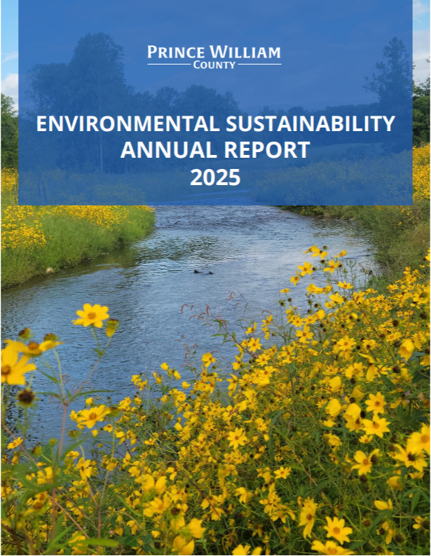
County’s first Environmental Sustainability Annual Report
Published April 15th
Large internal collaboration effort
First PWC Government Operations Greenhouse Gas (GHG) Emissions Inventory

Slide 29
Environmental Sustainability milestones
BOCS direction
PWC implementation
November 2020
Climate Mitigation and Resiliency Goals
March 2022
Office of Sustainability was established
October 2023
Community Energy and Sustainability Master Plan (CESMP)
Starting from 2024
Office of Sustainability leads the implementation
█████████████████░░░░░░░░ 17/25 high-priority actions initiated across County departments with limited resources
May 2024
Initiated Sustainability and Resiliency Comprehensive Plan Amendment (CPA)
February 2025
Strategic Plan including the Environment Goal
April 2026
Launch the Environmental Sustainability Annual Report
Feedback loop on progress and performance

Slide 30
Purpose of Annual Report
Annual update and feedback loop on progress and performance for county sustainability
An engagement tool highlighting key accomplishments
A driver of enterprise-wide momentum
County’s sustainability story within the region

Slide 31
Whole-of-government report development
All County agencies were consulted in the Annual Report development process
Safe & Secure Community
Mobility, Economic Growth & Resiliency
Government Operations,
Performance & Innovation
Health, Wellbeing &
Environmental Sustainability
Community Safety
Development Services
Facilities & Fleet Management
Area Agency on Aging
Finance
Criminal Justice Services
Economic Development & Tourism
Human Resources
Community Services
Office of Equity & Inclusion
Fire & Rescue
Planning
Human Rights
Housing & Community Development
Office of Transformation Management
Police
Public Works
Information Technology
Library
Office of Communications & Engagement
Public Safety Communications
Transportation
Performance Management
Parks & Recreation
Procurement Services
Social Services
Adult Detention Center
Strategic Planning
Youth Services

Slide 32

Whole-of-government report development
All County government energy users were consolidated into a single digital platform for utility bill payment and energy/emissions tracking
Safe & Secure Community
Mobility, Economic Growth & Resiliency
Government Operations,
Performance & Innovation
Health, Wellbeing &
Environmental Sustainability
Community Safety
Development Services
Facilities & Fleet Management
Area Agency on Aging
Finance
Criminal Justice Services
Economic Development & Tourism
Human Resources
Community Services
Office of Equity & Inclusion
Fire & Rescue
Planning
Human Rights
Housing & Community Development
Office of Transformation Management
Police
Public Works
Information Technology
Library
Office of Communications & Engagement
Public Safety Communications
Transportation
Performance Management
Parks & Recreation
Procurement Services
Social Services
Adult Detention Center
Strategic Planning
Youth Services

Slide 33
Whole-of-government report development
Agencies and partners are acknowledged in the report for their substantial environmental sustainability initiatives and collaborations
Safe & Secure Community
Mobility, Economic Growth & Resiliency
Government Operations,
Performance & Innovation
Health, Wellbeing &
Environmental Sustainability
Community Safety
Development Services
Facilities & Fleet Management
Area Agency on Aging
Finance
Criminal Justice Services
Economic Development & Tourism
Human Resources
Community Services
Office of Equity & Inclusion
Fire & Rescue
Planning
Human Rights
Housing & Community Development
Office of Transformation Management
Police
Public Works
Information Technology
Library
Office of Communications & Engagement
Public Safety Communications
Transportation
Performance Management
Parks & Recreation
Special thanks
Procurement Services
Social Services
VCE / Soil & Water District
Adult Detention Center
Strategic Planning
Youth Services
PWCS
Case study and/or standalone narrative

Slide 34
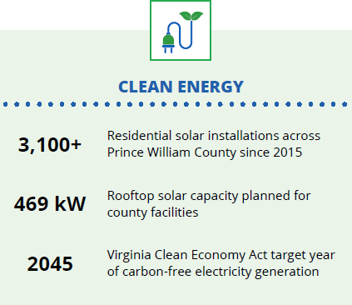
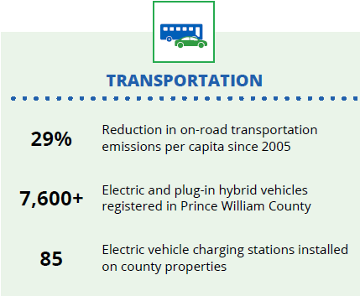
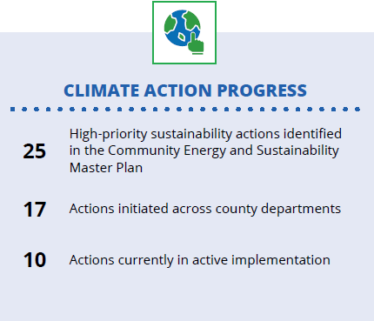
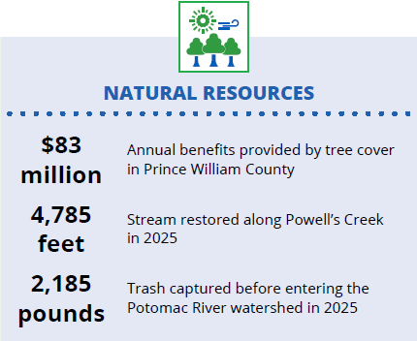
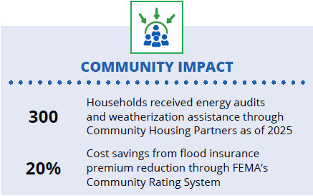
Headline accomplishments

Slide 35
Adaptive management in action
Adaptive Prioritization and Implementation
… the county recognizes that climate planning and implementation must remain flexible and responsive to changing conditions…
… applies an adaptive management approach that regularly evaluates the relevance, effectiveness, cost and benefits of each high-priority action. This approach allows the county to reassess assumptions, incorporate new data and technologies, respond to regulatory and funding changes, and adapt to evolving community needs…
… to balance costs and benefits, manage risks and sequence actions to maximize impact...

Slide 36
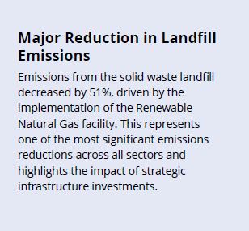
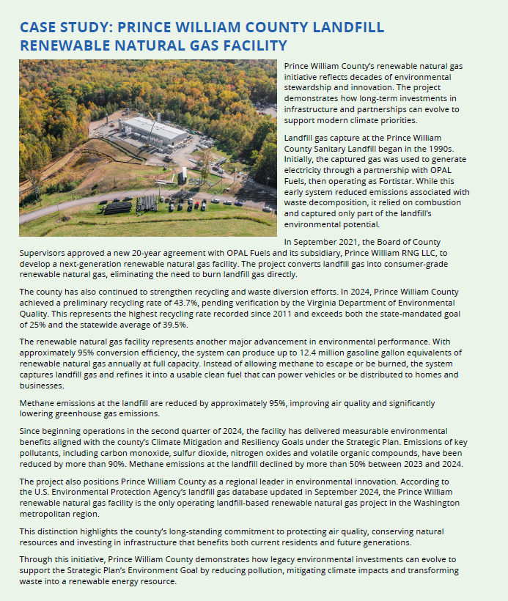
Case Study: Renewable Natural Gas Facility

Slide 37
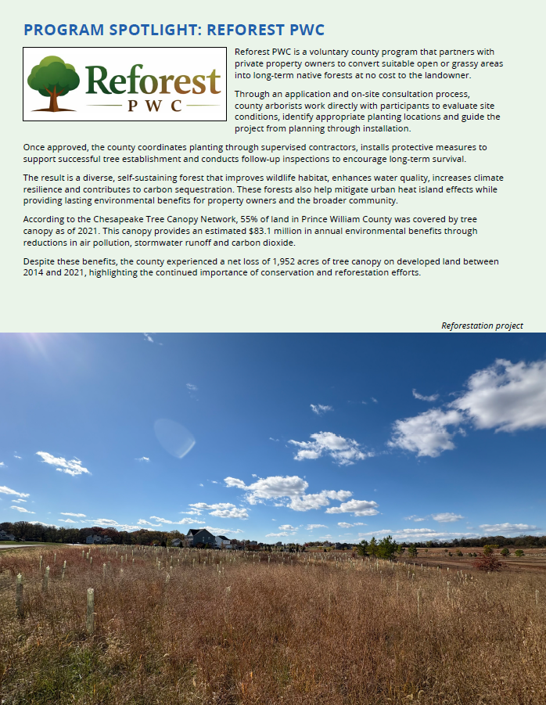
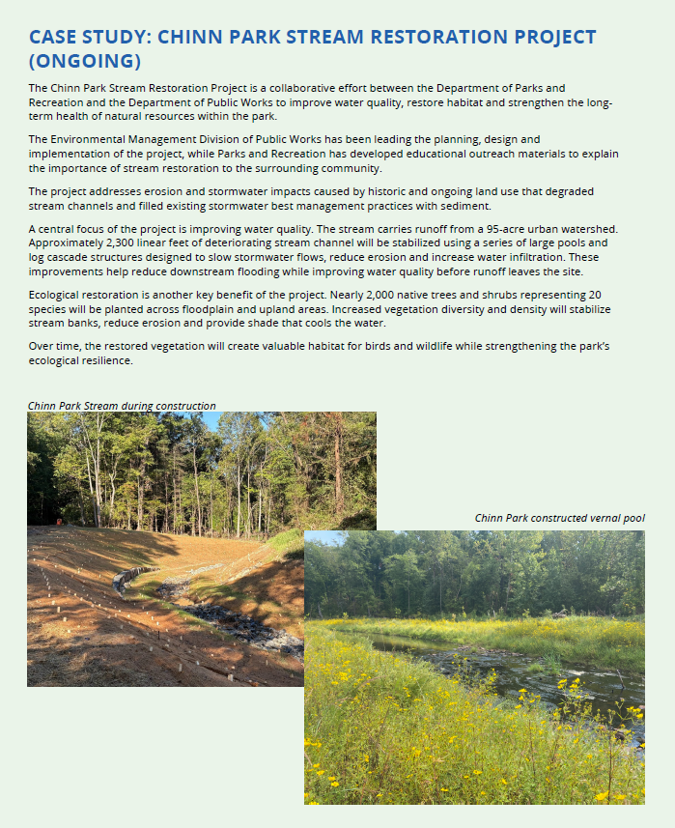
Case Study: Reforestation and Restoration

Slide 38

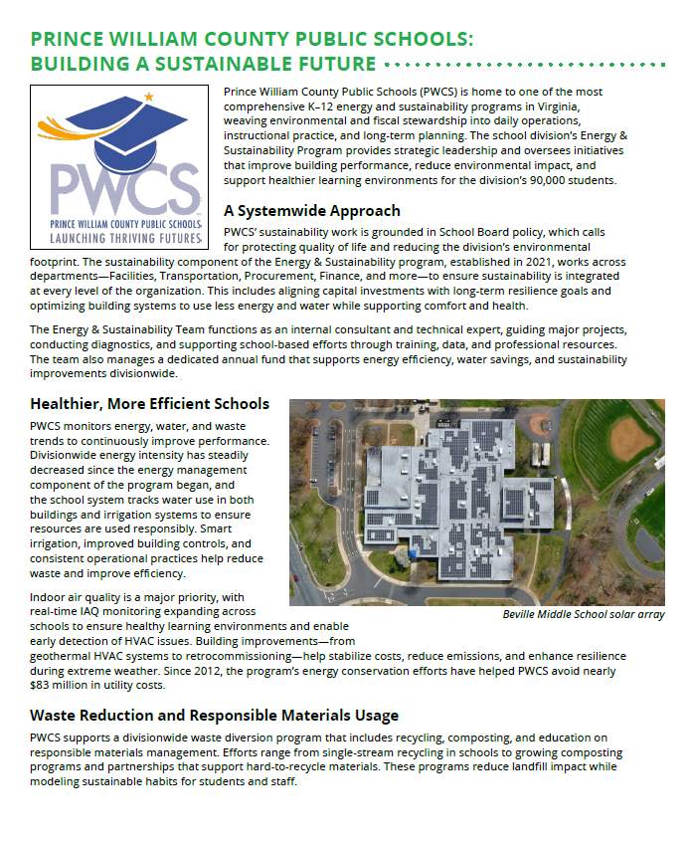
Case study: Libraries and Schools

Slide 39
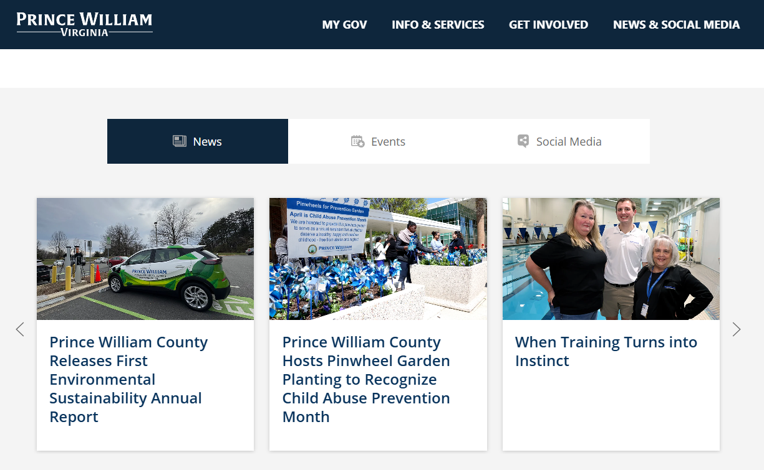
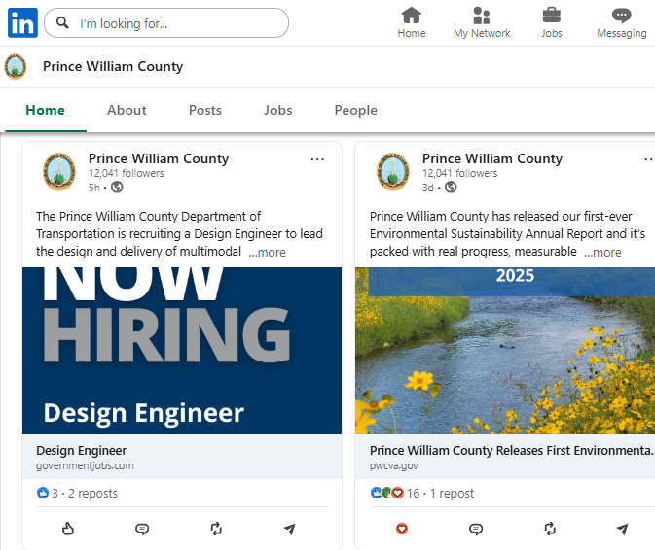
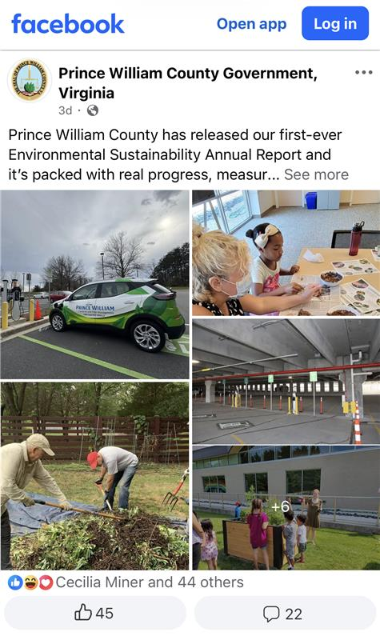
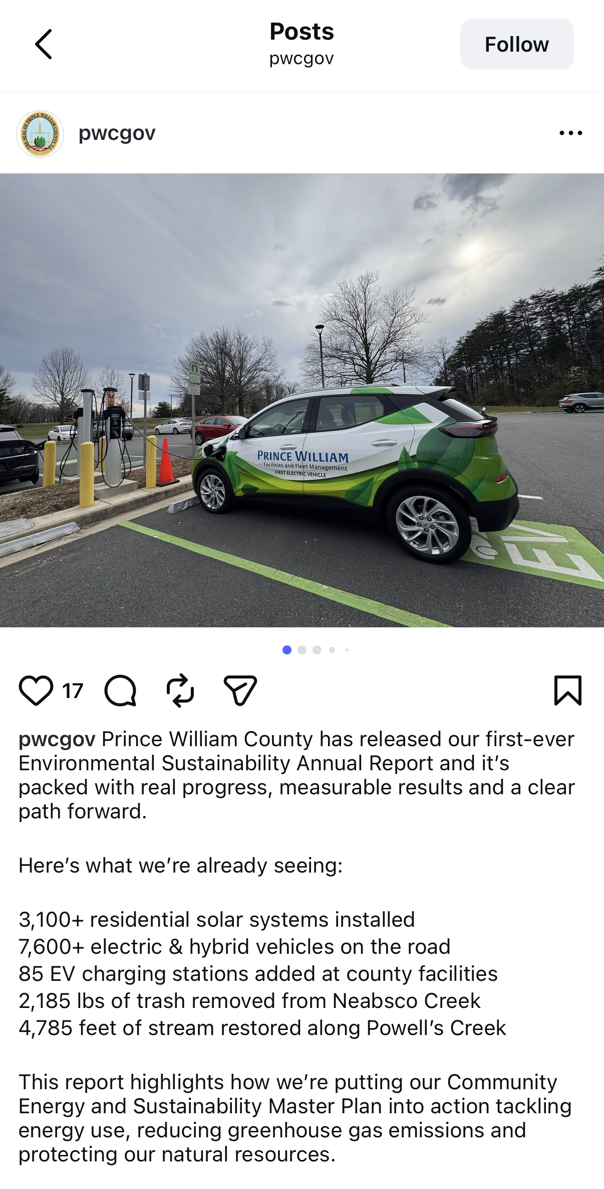
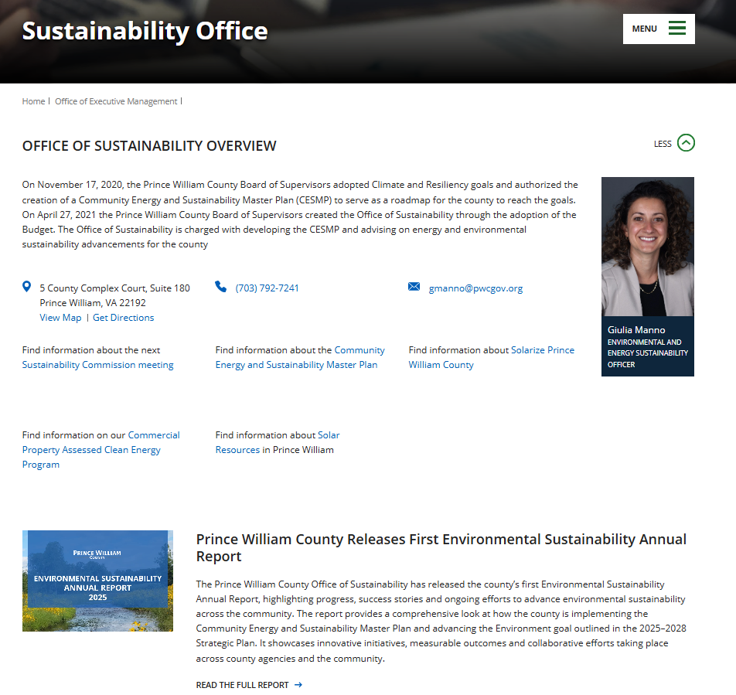
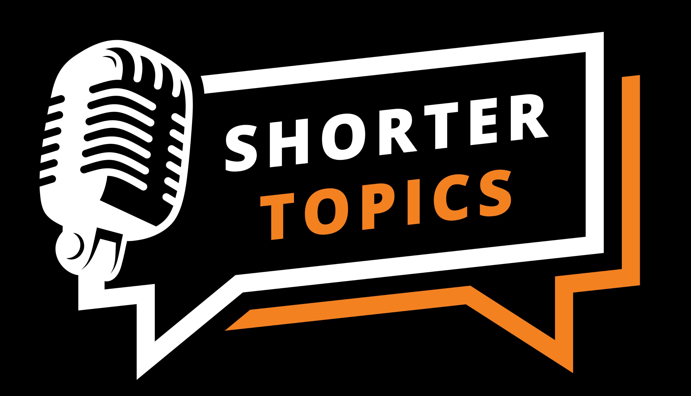

Communications
Upcoming

Slide 40
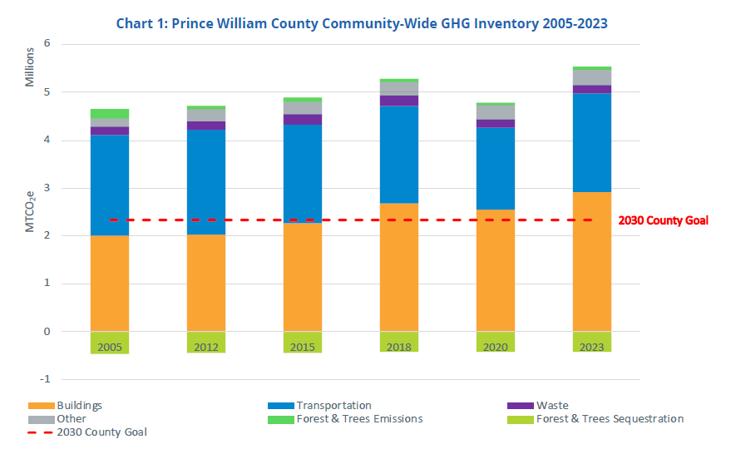
Overall emissions trend
Source: MWCOG GHG Summary Factsheet

Slide 41

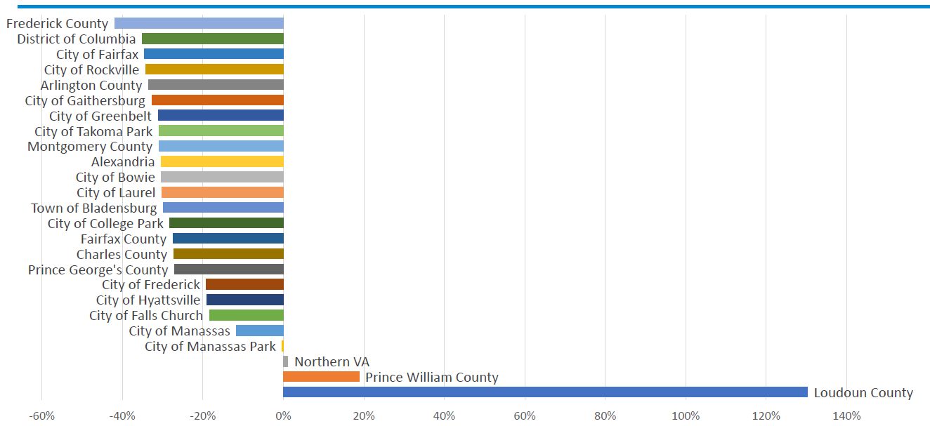
Report developed to accurately reflect GHG emissions
In response to the Board adopted Climate and Resiliency Goals, disclosure of County’s GHG emissions is a core component of the Annual Report
Reduce county-wide greenhouse gas (GHG) emissions by 50% from 2005 levels by 2030.
MWCOG conducts and publishes locality-scale GHG inventories for its member jurisdictions. The inventory is credible and well-validated, but also requires locality-level narrative to describe the key drivers and accomplishments.
Looking at total emissions, PWC GHG emissions +22% from 2005 to 2023
PWC and Loudoun are the only jurisdictions with increased emissions, due to rising commercial electricity use
% Change in Gross GHG Emissions by jurisdiction, 2005 - 2023
Source: MWCOG public information

Slide 42
Report developed to accurately reflect GHG emissions
On data centers
COG’s Comprehensive Climate Action Plan and the GHG inventory development took an attempt at estimating the GHG emissions impacts of data centers and opportunities for reductions based on limited available data and the fact that the data center industry is rapidly evolving and developing.
According to the modeling, it is estimated that 1.42 million metric tons in Prince William County in 2023 are associated with data centers’ grid electricity consumption, representing about 76% of emissions in the County associated with all commercial building emissions from grid electricity.
Note: This approach would preserve the future flexibility to disaggregate data center emissions from the County’s overall emissions profile.

Slide 43
Report developed to accurately reflect GHG emissions
The Annual Report provides a balanced summary of the GHG inventory, presenting accurate information and highlighting emissions reductions in the residential and non–data center commercial buildings
Buildings sector in PWC
Accounted for 53% of total emissions in 2023
Primary driver of emission increase
Data center electricity consumption driving the total commercial buildings emissions
⬆ 163%
Non-data center commercial buildings emissions ⬇ 29%
Residential buildings emissions ⬇ 28%

Slide 44
Report developed to accurately reflect GHG emissions
On residential buildings
Residential building emissions decreased by more than 28% between 2005 and 2023.
During the same period, the county added more than 37,000 housing units.
Improvements in building energy efficiency, electrification and electricity grid decarbonization offset the increase in housing units and floor space, resulting in this significant emissions reduction.

Slide 45
Report developed to accurately reflect GHG emissions
On non-data center commercial buildings
Despite the 47% increase in total square footage, the non-data center commercial buildings reduced the emissions from grid electricity by approximately 29%.
This reflects improvements in building efficiency and the ongoing transition to a cleaner electricity grid.

Slide 46
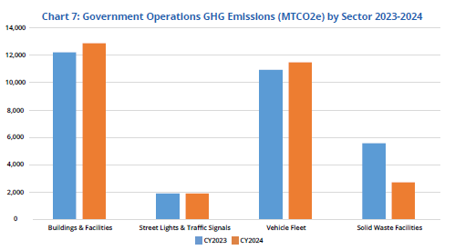
Government Operations Emissions
Prince William County achieved a 5.4% reduction in total government operations GHG emissions between 2023 and 2024.
Emissions from the solid waste landfill decreased by 51%, driven by the implementation of the Renewable Natural Gas facility.
This represents one of the most significant emissions reductions across all sectors and highlights the impact of strategic infrastructure investments.

Slide 47
Thank you for your time!

