Slide 1
Reiterating the SC Recommendation for a Pause on Data Center Approvals
Prince William County Sustainability Commission
Draft v1
July 23, 2026
Randy Freed

Slide 2


Objectives & Outline
Briefing Objectives:
  Review the case for reiterating/ expanding the Apr 2024 SC recommendation to pause approvals for data centers
  Decide on course of action
Outline
  Background – Apr 2024 SC Resolution
  Changes to the Apr 2024 status quo
  Options
  Next Steps

Slide 3
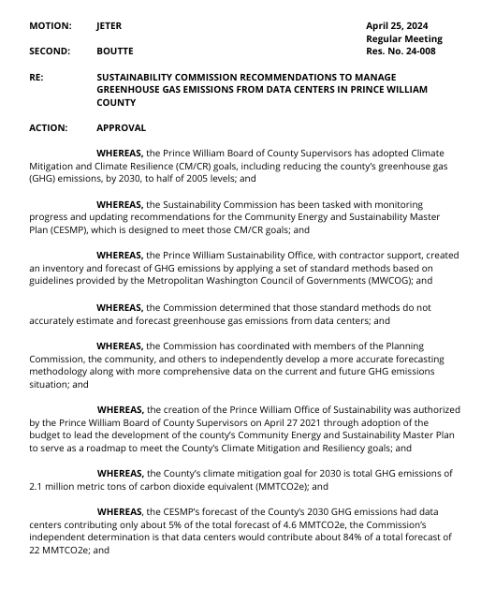
Background
SC approved, by acclimation, “SC Recommendations to Manage GHG Emissions from Data Centers in PWC” (SC24-008) in April 2024, with 3 key messages:
  NOW, THEREFORE, BE IT RESOLVED that the Commission recommends that the Board of County Supervisors (BOCS) examine ways to pause approvals on new data centers, including eliminating the opportunity zone and targeted industry status, until the county can (a) adequately analyze and manage cumulative impacts of data center development, including effects of additional data centers on the climate mitigation goal, and (b) the County can devise a method to condition approval of any additional data centers on binding commitments by the applicants to use at least 90% zero-carbon electricity by 2030.
  BE IT FURTHER RESOLVED that the Commission recommends that the BOCS and Office of Sustainability immediately prioritize CESMP Action E.3: Encourage Renewable Energy Use in Energy-Intensive Commercial Buildings, including developing a program to encourage, and if possible, require all existing and fully permitted data centers to commit to use at least 90% zero carbon electricity by 2030.
  BE IT FURTHER RESOLVED that the Commission recommends that the BOCS immediately prioritize the CESMP foundational initiative on “assessments for climate mitigation and resiliency impacts,” to be performed by the County to provide data on a project’s impact on GHG emissions, renewable and fossil energy mix, and climate resiliency metrics. These assessments should apply not only to new data centers, but also to road projects, residential/ commercial development, and other projects that could materially affect accomplishment of the CM/CR goals to insure that the goals are not further at risk.

Slide 4
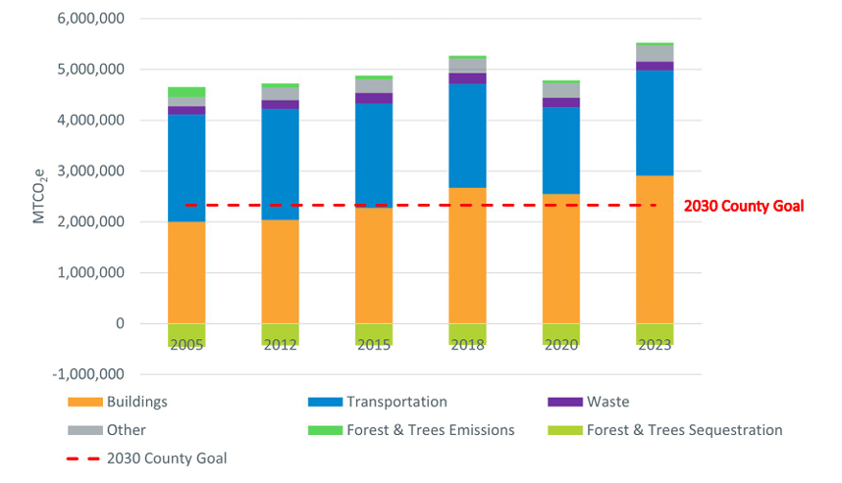
What hasn’t changed since Apr 2024?
PWC has one of the largest pipelines of new data center projects in the US, and probably the world.
Though the CESMP identified actions to start moving toward the goals of a 50% reduction in GHG emissions by 2030 and 100% RE by 2035, even if fully implemented, the plan would fall far short of those goals.
  The plan isn’t being fully implemented.
  Emissions are actually increasing rather than decreasing.
  New actions haven’t been identified to bridge the gap.
None of the actions in SC Resolution 24-008 have been implemented.

Slide 5
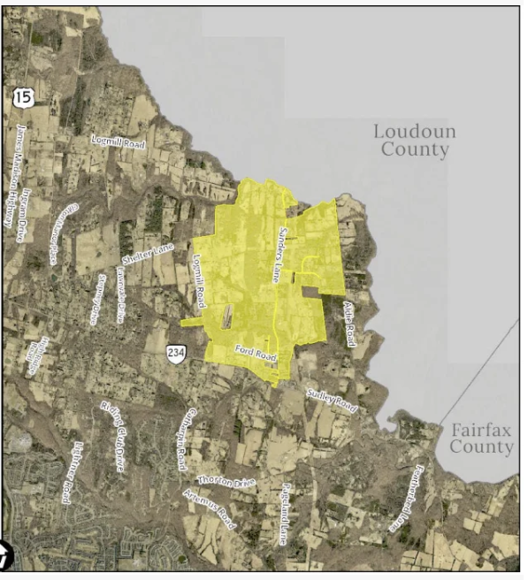
What has changed since Apr 2024?
Though the BOCS hasn’t examined ways to eliminate the opportunity zone and targeted industry status, in June 2026 it initiated a zoning text amendment that would substantially reduce the county’s Data Center Opportunity Zone Overlay District (DCOZOD) and end by-right data center development entirely by requiring Special Use Permits.
The PWC Planning Commission just issued a recommendation to the BOCS to end by-right development in PWC.
The world’s largest proposed data center (Dulles Cloud South) was proposed for PWC, but – in a first – it was rejected 8-0 by the BOCS. In this and in other public pronouncements, the BOCS has signaled new receptivity to mitigating impacts of data centers.
The connection queue for electricity in VA has transitioned from a manageable waiting list into a severe grid constraint crisis. Wait times have surged to >7 years, leading data centers to consider building on-site gas generation (one has already been built in Loudoun County).

Slide 6
What has changed since Apr 2024?
Other VA jurisdictions have “broken the ice” by issuing temporary prohibitions or changing their zoning:
    Town of Front Royal: instructed staff to draft language prohibiting data centers in every single zoning district and established a temporary moratorium on accepting or approving data center applications
    Loudoun County: ended by-right zoning for data centers, forcing all new applications to go through public hearings
    Spotsylvania County: Reclassified data centers to require a Special Use Permit, ensuring every single proposal is individually evaluated by the BOCS rather than approved automatically
    Warren County: Implemented highly restrictive zoning ordinances to severely limit data center expansion
  The SC has provided specific recommendations on how to mitigate data center impacts, in the form of our resolution on proffers and SUP conditions.

Slide 7
Changes to the Apr 2024 Status Quo
In sum, the prospects for meeting the GHG and RE goals are even dimmer than they were in 2024, and the BOCS hasn’t taken meaningful action on our recommendations. There’s a strong case that the need for action is even more urgent than before.

Slide 8
Options
No action
Reiterate Resolution 24-008 without changes
Reiterate and expand the resolution

Slide 9
Options
Potential expansions
  Change Comprehensive Plan and Zoning Ordinance to tightly limit where data centers can go. Currently in PWC, there are lots of zoning classifications that allow data centers. The BOCS is currently looking at tightening up the Overlay area, but that would still leave a lot of areas with zoning classifications that allow data centers. The county could distill that down to only areas zoned heavy industrial.
  Require a SUP for all data centers, then deny any SUPs that aren’t in heavy industrial areas and/or don’t incorporate adequate mitigation measures. The BOCS is already moving towards eliminating by-right data center applications and requiring a SUP, but there would need to be buy-in on the part of staff, the PC, and the BOCS on this.
  Explicitly restrict on-site, non-emergency, fossil fuel electricity generation. As the connection queue grows, there will be more pressure to replicate the tactics of the Vantage facility in Loudoun, i.e., to install on-site gas generation.
  Other elements?

Slide 10
Next Steps
Draft revised/updated resolution
Circulate by email prior to next meeting, and aim to vote in August.
Commissioners meet with Supervisors to communicate need for action

Slide 11





Discussion

