Slide 1
Scoping Analysis:
Carbon Emissions from the Dulles Cloud South Project
Prince William County Sustainability Commission
Draft v1
July 23, 2026
Randy Freed

Slide 2


Objectives & Outline
Briefing Objectives:
  Provide back-of-the-envelope analysis of carbon emissions from Dulles Cloud South proposal (voted down by BOCS)
  Provide example calculation that PWC could use to fulfill CESMP recommendation to assess climate mitigation impacts
Outline
  Background
  Scenarios: Assumptions & carbon emission estimates
  Implications

Slide 3

Background
PWC climate, energy, and sustainability goals
  The MWCOG regional Climate Mitigation (CM) Goal of 50% greenhouse gas (GHG) emission reductions below 2005 levels by 2030,
  The MWCOG regional Climate Resilience (CR) Goal of becoming a Climate Ready Region and making significant progress to be a Climate Resilient Region by 2030.
  A county-specific goal for Prince William County Government operations to achieve 100% renewable electricity by 2030,
  A county-specific goal of 100% of Prince William County’s electricity to be from renewable sources by 2035, and
  A county-specific goal for Prince William County Government operations to be 100% carbon neutral by 2050.

Slide 4

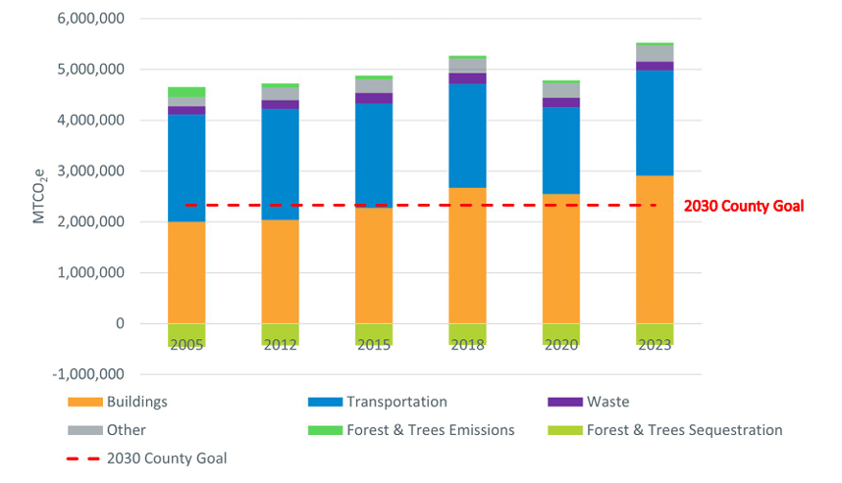
Background
Community Energy & Sustainability Master Plan (CESMP) puts 2030 county-wide GHG goal at 2.1 million tons CO2e.
Per MWCOG’s most recent inventory (MWCOG PWC GHG inv Mar 2026), PWC is not on track to hit the goal, with emission growth primarily from data centers:

Slide 5
Background
The Dulles Cloud South (DCS) Comp Plan Amendment (CPA) initiation was for a 43 million sq ft data center, almost twice the size of the PWDG (22 MSF). The SC had done screening estimates of carbon emissions from PWDG indicating that it would be a dealbreaker for the county’s carbon goals.
The CPA initiation failed on an 8-0 vote in the July 7 BOCS meeting. Nonetheless, the fact that such a huge project could emerge without careful consideration of implications on the CM (and CR) goals indicates that we have a problem with the decisionmaking process.

Slide 6
Background
CESMP includes 3 foundational initiatives, including “Assessments for climate mitigation and resiliency impacts performed by the County to provide data on a project’s impact on greenhouse gas emissions, renewable and fossil energy mix, and climate resiliency metrics.” So far, none of these assessments have been provided to the BOCS, so the BOCS is flying blind.
  To backfill, I provided estimates to Sup. Boddye for his consideration before the DCS vote.

Slide 7
Scenarios: Assumptions & Estimates

Slide 8
Major Caveats
Full build-out would probably take well more than 4 years (2030) and even if construction could proceed that fast, Dominion has a >7 year wait to supply power, so the grid carbon intensity value for 2030 may not be appropriate.
If the applicant committed to use clean (zero-carbon) electricity to supply some or all of their demand, emissions would be lower.
Given the fast pace of increased electricity intensity for data center equipment, the 2023 energy intensity value for Loudoun County likely understates future energy intensity (perhaps by a lot).

Slide 9
Implications
Emissions from this single (colossal) project would likely exceed PWC’s climate mitigation goal (2.1 MMTCO2e).
The absence of climate mitigation/ resilience assessments prior to BOCS consideration of CPAs, rezonings, special use permits, and other key decisions leaves a continuing gap in the decision support process that puts attaining the CM/CR goals at significant risk.
This gap needs to be filled immediately, or else PWC should prohibit new data centers until it has an adequate assessment and mitigation framework in place.

Slide 10





Questions?

